Slide 1
Creating a Best-in-Class Omnichannel WBA CX
Cognizant’s Project Fiore Proposal
MARCH 2020

Slide 2
We are the best partner to deliver this solution.
We assembled and orchestrated a team of 50+ experts across 10 technologies, 4 marketing disciplines, and 3 continents to pull together a highly integrated and detailed scope, solution architecture, project plan, staffing plan, and costing – all tied together with cross-track dependencies identified and workplans aligned. “I”s dotted, “T”s crossed.
We think this type of skillset breadth, mobilization ability, geographic distribution, and dedication is exactly what Walgreens will need to be successful. Project Fiore will be a challenge to deliver in your timelines with our fully integrated team, but we think it’ll be nearly a mission impossible without it.
We are a new side of Cognizant. We are Cognizant Digital.
What a week!

Slide 3
CONTENTS
01 Setting the Context
02 Who We Are
03 How We’ll Deliver
04 Our Recommended Execution Plan
05 Governance & Team
06 Commercials

Slide 4
Setting the Context

Slide 5




What we understand
CREATE A MODERN UNIFIED WBA CX Integrate pharmacy, retail, in-store, and digital channels into a differentiated personalized, individual customer experience
DRIVE MEANINGFUL HUMAN CONNECTIONS Connect with customers and patients in new ways, taking advantage of the breadth of WBA’s service offerings to drive growth through more personal, intimate relationships
HARNESS THE POWER OF DATA Provide deeper integration, engagement, and federated data across the WBA enterprise to expose new experiences and information to customers and patients
DEVELOP A MODERN SCALABLE TECH PLATFORM Build a modern, scalable, agile technology platform to enable world-class digital capabilities today and in the future
WBA is eager to find a partner to help power Project Fiore as part of its digital CX modernization efforts.

Slide 6
01
Your ask with Project Fiore
Harmony
Wonder Woman
Walgreens MarTech
Boots MarTech
Walgreens Marketing Campaign Execution
Boots Marketing Campaign Execution
02
03
04
WBA is looking for both an implementation & marketing campaign partner to realize the benefits of Project Fiore for Walgreens & Boots.
05
06

Slide 7
OUR GOAL
Partner with WBA to establish the capabilities required to create a best-in-class omnichannel CX by leveraging our knowledge of WBA’s existing business and expertise in digital marketing & technology.

Slide 8
We’ve done this before, and we understand the challenges WBA will face.
WBA’s CHALLENGE
COGNIZANT’S SOLUTION
Multiple, interdependent, global project workstreams across technology & marketing
Sensitivity around healthcare data security
Need to build a stable technological infrastructure
Introduction of new technologies to the WBA ecosystem
Aggressive timeline for program delivery
Injecting organizational change with new platforms, tools, and processes
Experienced Modernization Program Office to manage and align the workstreams & dependencies
Bringing our deep healthcare expertise & understanding WBA’s systems & data
Deploying Azure SMEs to seamlessly integrate technologies
Providing our expertise and partnerships with Adobe & Microsoft
Delivering with an E2E, integrated, agile team
Applying a change management & adoption program with our understanding of WBA’s existing environment

Slide 9
Who We Are

Slide 10


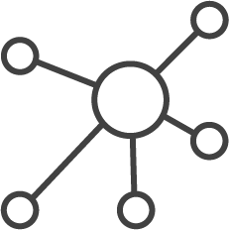
A leading digital partner with global scale delivering world class experiences for our clients
Cognizant
Digital
From foresight services and experience design, to digital marketing & systems integration, we help some of the world’s leading digital Brands envision and operate tomorrow’s products and experiences today.
We have grown by being client centric. We always have a POV, but we will operate how you want to operate and be flexible with how we deliver to meet your needs.
Our bespoke services, leveraging an international network of digital experts across our global offices, allow us to deliver boutique service at global scale – scaling to meet the needs of even the largest and most complex programs.

Slide 11





Global integrated product engineering with scale and agility
70+ | 6,500 | 1,150 | 20,000 | 1,650 | 15,000 | 7,000
Offices Globally | Experience Designers | Marketing Consultants | Digital Engineers | Commerce Specialists | Data Engineers | AI Specialists
KEY DIVISIONS
London
Amsterdam
Toronto, ON
Paris
Romania
Chicago
New York
Philadelphia
Madrid
Shanghai
Osaka
San Francisco
Dallas
Mexico
Tampa
Pune
INDUSTRY RECOGNITION
Hyderabad
Costa Rica
Chennai
Manila
#1 Digital Agency Network in the US
#3 Digital Agency Network in the World
2018 & 2019 Agency Report
Brazil
Melbourne
8
Argentina

Slide 12









We are a leading digital partner in pharmacy, retail, & hospitality
CX CLIENTS IN PHARMACY, RETAIL & Hospitality

Slide 13
We are a global healthcare leader with an unrivaled client base across healthcare
PAYERS
400+ Payer Organizations
PBMs
3 of the 5 leading US PBMs
195 million
lives
on one or more of Cognizant’s software platforms
PROVIDERS
340+ health systems and
347,000+ care providers supported through over
400 PM/EHR partners
GOVERNMENT
13 state governments and
30 state and federal exchanges
34,000+ ASSOCIATES
supporting healthcare

Slide 14










We have a deep understanding of WBA’s business, systems, data, and technology
10+ | 5+ | 3+ | 1,400
Years as major strategic partner | Years as primary pharmacy partner | Years as primary development partner | Associates supporting WBA globally
WHAT WE’VE ACCOMPLISHED TOGETHER
Co-developed Walgreens ecommerce platforms | Built the OMS & mobile app | Running business transformation program for Cost to Fill | Running integration infrastructure and projects for 2+ years | Migrating digital ODS into Azure with near real time data availability
Primary WBA QA partner globally ~80% of all global QA | Top AppDev partner globally & highest quality by quarterly supplier assessment | Support supply chain BPO | Building the new Digital Health Platform for the UK | Core Pharmacy: Dev and RunOps partner for IC+

Slide 15













We’re Adobe’s largest multi-solution global partner
COGNIZANT – ADOBE CENTER OF EXCELLENCE
Enabling business across industries to deliver engaging experiences to drive acquisitions, conversions and loyalty, using Adobe Experience Cloud.
EXPERIENCE
MANAGER
ADVANCED
ANALYTICS
CAMPAIGN
MANAGER
AUDIENCE
MANAGER
TARGET
MARKETO
MAGENTO
Cognizant is the only Adobe Global Alliance Solution Partner with 5 specializations: Adobe Experience Manager, Adobe Analytics, Adobe Campaign, Adobe Target and Adobe Experience Manager Sites: Run & Operate
// ADOBE PRACTICE QUICK STATS
// EXPERIENCE ACROSS MULTIPLE INDUSTRIES
1500+
ADOBE CONSULTANTS
450+
AEM CERTIFIED CONSULTANTS
95%
REPEAT BUSINESS
Retail and
Consumer goods
BFS and insurance
Life sciences and healthcare
Travel and Hospitality
200+
ADOBE ANALYTICS AND TARGET CERTIFIED CONSULTANTS
250+
ADOBE CAMPAIGN
CERTIFIED CONSULTANTS
200+
CLIENTS
Auto
Energy and Utility

Slide 16
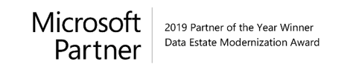


We have a $1B+ Microsoft business, making us a top global partner
370+
750+
1750+
270+
400+
Clients
Projects
Consultants
Azure Certified
Associates
Awarded Cortana digital badges from Microsoft
KEY OFFERINGS
RECOGNITIONS
SERVICE PORTFOLIO
CIMBA(Cognizant Intelligent Microsoft Bots in Action)
Cognizant Data Modernization Method
Data Modernization Platform- BigDecisions
BigFrame
2019 Partner of the Year- Data Estate Modernization
2019 CII Excellence Awards | Best of CII - Category: Technology Innovation
2018 Big Data Analytics Partner of the Year
2018 HfS Ranking # 2- among Top 10 Cognitive Assistant Service Provider
2018 Top performer 2018 Microsoft Platform Modernization Database Innovation GSI Award
2017 Microsoft Data Platform Partner of the Year
Expert Services
Migration Services/ DB Upgrade
Data Estate Modernization
Visualization
Platform Modernization
IOT / Real time Streaming
Predictive & Prescriptive Analytics
AI
16

Slide 17
How We’ll Deliver

Slide 18
We bring together product, digital marketing & engineering to deliver better outcomes, faster
OUR
STARTING
THREE
MAKE SMART DECISIONS
Understand the Walgreens & Boots use cases
Define the problem and the vision to solve it
Ensure decisions are made to maximize business value by both digital marketing & engineering
PRODUCT
MANAGENT
DIGITAL MARKETING
DELIVER WITH SPEED & QUALITY
End the supply chain – gets insight as close as possible to the code
Have value-based framework for where to invest story points during requirements/design/architecture
Keep the project in balance to maximize return within timeline/budget – or make value based arguments for more time & budget to maximize return
ENGINEERING

Slide 19
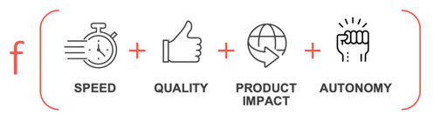
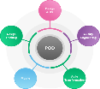
And organize into integrated, self-reliant, agile pods to ensure collaboration & alignment across the workstreams
The Pod Methodology provides a framework that can be tailored to promote effective delivery and sustainability by:
Keeping lean and solid process
Measuring KPI-driven performance
Providing the ability to easily scale without impacting team performance
The Pod Model
Pod Framework
Development Framework
Pods combine talent from digital marketing to technology
The Core “DNA” of the pods intersects our digital expertise and intimate knowledge of our clients.
Cross-functional agile teams
Ideal size: 8-10 people
Autonomous + responsible for end-to-end solutions
Focused on meeting WBA’s objectives
Pod
The Development Framework will be defined with WBA, likely will be Scrum of Scrums given Walgreens & Boots SDLC preference on other programs.

Slide 20



And build with a foundation of modern digital engineering principles
By improving
Product Velocity
tdd
By improving business efficiency with
Platform Automation
TECHNICAL COMMUNITY
AGILE
CI / CD
By achieving greater
Developer Productivity
leveraging technology
Powering
Cognizant
Software
Engineering
By improving success with
De-Risked Migration
leveraging IP
PODs
BML
BALANCED
The principles of Cognizant Digital Engineering teams comes with the importance of empathy
Concious and deliberate empathy is at the heart of everything we do. When we have empathy for each other, we have empathy for the customer.
FEEDBACK
ELIMINATE
WASTE
MVP

Slide 21
Our Recommended Execution Plan

Slide 22
End-to-End Program Recommendation

Slide 23
We recommend a globally orchestrated, locally deployed program that will:
Build a strong, scalable, and configurable platform that enables Harmony, Wonder Woman, & marketing campaigns
Providing consistency globally, while enabling infinite flexibility locally
Support & executes WBA’s digital marketing use cases
Preparing the WBA organization for change & adoption to new ways of working in Microsoft & Adobe tools
Notes:
Globally orchestrated, locally deployed

Slide 24
Our solution is globally consistent, yet brand specific
Harmony
Wonder Woman
Adobe Experience Cloud
Walgreens Marketing
Use Cases
Boots Marketing
Use Cases
Marketing Operations
eAPI / Domain Services
OMS / Microsoft F&O
CDP / Microsoft CI + Azure Data Services

Slide 25
Using a loosely coupled but highly interoperable multi-tiered architecture

Slide 26
Project Fiore Integration Partner End-to-End Program View
APRIL |  | MAY |  |  |  | JUNE |  |  |  |  | JULY |  |  |  | AUG |  |  |  |  | SEP
20 | 27 | 4 | 11 | 18 | 25 | 1 | 8 | 15 | 22 | 29 | 6 | 13 | 20 | 27 | 3 | 10 | 17 | 24 | 31 | 7 | 14
Foundation
Harmony
Wonder Woman
Walgreens Marketing
Boots Marketing
S1
Discovery
Environment Setup
F&O Onboarding
Governance Design
S2
Architecture
Integ. Blueprinting
CI Blueprinting
Adobe Blueprinting
Establish MPO
S3
Configuration
Data Modeling
Security Review
Blueprint Approval
OCM Blueprinting
OCM Post-Implementation
MODERNIZATION PROGRAM OFFICE (MPO) GOVERNANCE CADENCES
ORGANIZATIONAL CHANGE MANAGEMENT ENTERPRISE ENGAGEMENT & LEARNING IMPLEMENTATION
S3
System Design
Story Elaboration
Backlog Grooming
S4
CI Profile Unification
CI Data Ingestion
F&O Config Build
S5
Domain API Profile
CI Data Ingestion
F&O Submaster & Sales Order Setup
S6
OMS Service Bus
Unified Profile API
CI Segments Config
S7
Domain API
CI Outbound Integ.
Sales Order API
S8
Upstream to CI/OMS System Flow
Regression & Performance Testing
UAT Support
S9
S10
Launch Planning
S11
Launch
Hypercare
S3
System Design
Story Elaboration
Backlog Grooming
S4
API-SVOC
Data Ingest–SVOC Profile Unif–SVOC
S5
API–CRM/Mobile
Data Ingest–Mobile Profile Unif–CRM & Mobile
S6
API–CM/DB
Data Ingest.–CM/DB CI Measure/Segment
S7
API–Demographics
Ingest.–Data Lake
Outbound–PII/non
S8
Upstream to CI/OMS System Flow
SIT Regression & Performance Testing
UAT Support
S9
S10
Launch Planning
S11
Launch
Hypercare
S3
ACC–Metadata
Launch–Config
CI–Story Elaboration
API–Integ. Spec
S4
ACC–Schema
AEM–Components
AEM–Email Temp.
AA/ACC Integ,
API–Stub Delivery
S5
ACC–Folders
AAM–Integrations
AEM–Exp. Fragments
AAM/AT Integration
CI–Prep Segments
S6
AAM–Data Enable
AEM–Workflow
AEM–Asset Cleanup
AT–Design Exper.
API– SIT Ready
S7
AEM – Content Sync
AT–Mail/Web Target
CI–Predict. Intel.
S8
AEC SIT +UAT Support
AA–Dashboard Development
CI–Data Access to AEC
API–Test Data Ready
S11
Launch
Hypercare
S9
S10
Launch Planning
AEM – Assets Publishing
CI/API–UAT + Prod Environment Ready
S3
ACC–Metadata
Launch–Config
CI–Story Elaboration
API–Integ. Spec
S4
ACC–Schema
API–Stub Delivery
S5
ACC–Folders
AEM–Components
AEM–Exp. Fragments
AAM/AT Integration
CI–Prep Segments
S6
AAM–Data Enable
AEM–Workflow
AA–Funnel Tagging
API–SIT Ready
S7
AEM – Content Sync
CI–Predict. Intel.
S8
AEC SIT +UAT Support
AA–Dashboard Development
CI–Data Access to AEC
API–Test Data Ready
S11
Launch
Hypercare
S9
S10
Launch Planning
AEM – Assets Publishing
CI/API–UAT + Prod Environment Ready

Slide 27
Project Fiore Campaign Execution Partner End-to-End Program View
APRIL |  | MAY |  |  |  | JUNE |  |  |  |  | JULY |  |  |  | AUG |  |  |  |  | SEP
20 | 27 | 4 | 11 | 18 | 25 | 1 | 8 | 15 | 22 | 29 | 6 | 13 | 20 | 27 | 3 | 10 | 17 | 24 | 31 | 7 | 14
Global
Walgreens Marketing
Boots Marketing
S3
System Design
Story Elaboration
Backlog Grooming
S4
CI Profile Unification
CI Data Ingestion
F&O Config Build
S5
Domain API Profile
CI Data Ingestion
F&O Submaster & Sales Order Setup
S6
OMS Service Bus
Unified Profile API
CI Segments Config
S7
Domain API
CI Outbound Integ.
Sales Order API
S8
Upstream to CI/OMS System Flow
Regression & Performance Testing
UAT Support
Launch
S9
S10
Launch Planning
S11
Launch
Hypercare
S3
System Design
Story Elaboration
Backlog Grooming
S4
API-SVOC
Data Ingest–SVOC Profile Unif–SVOC
S5
API–CRM/Mobile
Data Ingest–Mobile Profile Unif–CRM & Mobile
S6
API–CM/DB
Data Ingest.–CM/DB CI Measure/Segment
S7
API–Demographics
Ingest.–Data Lake
Outbound–PII/non
S8
Upstream to CI/OMS System Flow
SIT Regression & Performance Testing
UAT Support
Launch
S9
S10
Launch Planning
S11
Launch
Hypercare
S3
ACC–Metadata
Launch–Config
CI–Story Elaboration
API–Integ. Spec
S4
ACC–Schema
AEM–Components
AEM–Email Temp.
AA/ACC Integ,
API–Stub Delivery
S5
ACC–Folders
AAM–Integrations
AEM–Exp. Fragments
AAM/AT Integration
CI–Prep Segments
S6
AAM–Data Enable
AEM–Workflow
AEM–Asset Cleanup
AT–Design Exper
API– SIT Ready
S7
AEM – Content Sync
AT–Mail/Web Target
CI–Predic. Intel.
S8
AEC SIT +UAT Support
AA–Dashboard Development
CI–Data Access to AEC
API–Test Data Ready
S11
Launch
Hypercare
S9
S10
Launch Planning
AEM – Assets Publishing
CI/API–UAT + Prod Environment Ready

Slide 28
Implementation Partner

Slide 29
Developing the Foundation
We will start by building playbooks and common infrastructure for CDP, eAPI, and Adobe that brings consistency to Walgreens and Boots implementations for supportability & maintainability, while giving each Brand infinite flexibility to maximize their results and ensure they are never limited by the decisions of the other.

Slide 30
OVERCOMING KEY CHALLENGES
eAPI is the lynchpin for delivering all personalization data – it’s extension must be on-time & on-quality to hit your timeline.
Cognizant is WBAs largest eAPI partner, a highly successful technology project, and run the IPOMS & ICE CoE - we are a proven partner to extend eAPI for these use cases
We will ensure conformance with your existing eAPI program guidelines, delivering predictable quality and supportability/maintainability
Your timeline is aggressive - we know the eAPI program and won’t waste a minute on KT
© 2020
30

Slide 31
What’s needed to start: setting up the foundation
WHAT WE’LL NEED TO ENSURE SMOOTH & TIMELY DELIVERY OF THE PROGRAM FOUNDATION.
01
02
03
FINAL REQUIREMENTS Prioritized and signed off use cases for the implementation | ENVIRONMENT READINESS Infra and software licenses for CI & access to Life Cycle Services (LCS) for spinning out D365 F&O VM, Azure Services | TOOLS, PROCESS, TECHNOLOGY DOWNLOAD WBA sharing of current system landscape, standards, patterns, & processes
ENTITIES & RELATIONSHIPS Availability/readiness of CI source data dictionaries with key entities & relationships | DATA PROFILING Access to existing data profile report & sample entity diagram for conceptualizing OMS | EXISTING INTEGRATION PATTERNS Integration patterns for the source systems (eAPI) & sample inbound/outbound integration approach
SECURITY SIGNOFF Availability of enterprise security standards & security sign-off on all software components (e.g. D365 CI) | BUSINESS CAPABILITIES Availability of business capabilities matrix for D365 F&O and customer domain | AZURE CONFIGURATION WBA IT support with access to Azure Portal for integration configuration
04
05
06
07
08
09

Slide 32
The result: a global, consistent, & reusable playbook to power the CX platform for WBA
FOUNDATIONAL BLUEPRINT
KEY BENEFITS OF FOUNDATION
Promotes rapid development by letting project team focus on functional block
Increased productivity on application development for future projects
Technology & platform standardization across Boots & Walgreens
Future-proofed reference blueprint
Reusable templates/patterns
Playbook
(Environment Setup)
Platform Components for Cloud Native
Data Strategy
Bootstrap
(Microservices)
Integration Patterns
Reusable Templates
(Adobe)
Define Conceptual Data Model
Security
DevOps Setup
Reference Architecture
(Services, Data Governance, Policies, Best Practices)

Slide 33
Developing the foundation: track sprint activities & outputs
Foundation Track: Sprint 1 (2 WEEKS) | Foundation Track: Sprint 2 (2 WEEKS) | Foundation Track: Sprint 3 (2 WEEKS)
Kickoff On-board core team Common Platform Foundation – Discovery Initiate Environment setup Initiate reference blueprint Customer On Boarding for D365 F&O | DevOps Pipeline setup Architecture - Security, Azure, Integration Verification of CI installation/access Integrations - establish Patterns and interface blueprint Verification of CI Requirements CI Conceptual Data Modeling Spin Out D365 F&O Dev VM Adobe marketing solution blueprint | Complete all config Complete Reference blueprint Security Reviews & signoff Data model Review & signoff All blueprints review & signoff Application architecture review & signoff Setup user machine and build machine D365 F&O Dev VM
License & Tools Readiness Required Access for Adobe, Azure Availability of CI (SaaS) and F&O (SaaS) environment Access to Life Cycle Services for D365 F&O VSTS URL and access to VSTS | Security standards and guidelines Consent Management, & Customer Preferences CI BRD and FRS Source Data Dictionaries | Validation of all configuration Azure and Security alignment. Integration Patterns complete and tested with MVP Draft Data Model available for review. All data sources identified and verified.
// ACTIVITIES
// KEY DEPENDENCEIS
OUTCOMES
Foundation platform setup
Architecture blueprint
DevOps Pipeline
Security Signoff
MVP Integration service
CI Conceptual Data Model

Slide 34
Setting up the foundation: track sprint activities & outputs
Foundation Track: Sprint 1 (2 WEEKS) | Foundation Track: Sprint 2 (2 WEEKS) | Foundation Track: Sprint 3 (2 WEEKS)
Kickoff On-board core team Common Platform Foundation – Discovery Initiate Environment setup Initiate reference blueprint Customer On Boarding for D365 F&O | DevOps Pipeline setup Architecture - Security, Azure, Integration Verification of CI installation/access Integrations - establish Patterns and interface blueprint Verification of CI Requirements CI Conceptual Data Modeling Spin Out D365 F&O Dev VM Adobe marketing solution blueprint | Complete all config Complete Reference blueprint Security Reviews & signoff Data model Review & signoff All blueprints review & signoff Application architecture review & signoff Setup user machine and build machine D365 F&O Dev VM
License & Tools Readiness Required Access for Adobe, Azure Availability of CI (SaaS) and F&O (SaaS) environment Access to Life Cycle Services for D365 F&O VSTS URL and access to VSTS | Security standards and guidelines Consent Management, & Customer Preferences CI BRD and FRS Source Data Dictionaries | Validation of all configuration Azure and Security alignment. Integration Patterns complete and tested with MVP Draft Data Model available for review. All data sources identified and verified.
// ACTIVITIES
// KEY DEPENDENCEIS
OUTCOMES
Foundation platform setup
Architecture blueprint
DevOps Pipeline
Security Signoff
MVP Integration service
CI Conceptual Data Model

Slide 35
Timeline view of the foundation track
APRIL |  | MAY |  |  |  | JUNE |  |  |  |  | JULY |  |  |  | AUG |  |  |  |  | SEP
20 | 27 | 4 | 11 | 18 | 25 | 1 | 8 | 15 | 22 | 29 | 6 | 13 | 20 | 27 | 3 | 10 | 17 | 24 | 31 | 7 | 14
All
Dynamics F&O
CI
API
Adobe
S1
Kick-off
Discovery
Environment Setup
Reference Blueprint
Governance Design
S2
DevOps Setup
Arch – Security, Int. Azure
Integration Pattern + Interface Blueprint
S3
Complete Config
Complete Reference Blueprint
Security Approval
Blueprint Approval
Arch. Approval
S1
F&O Onboarding
S2
Spin Out Dev VM
S3
Setup User & Build VM
S1
S2
Verify installation + access
Verify Requirements
Conceptual Data Modeling
S3
Data Model Approval
S1
S2
S3
S1
S2
Solution Blueprint
S3

Slide 36


Developing the foundation: pod structure
BASED ON EXECUTION PLAN, THE FOUNDATION TEAM WILL BE DIVIDED INTO MULTIPLE PODS TO STREAMLINE DELIVERY.
 | Program pod | Foundation pod
Product Manager
Enterprise Architect
Azure Cloud Architect
CDP Architect
AEM Architect
ACM Architect
Integration Lead
AEM Lead
ACM Lead
Functional Consultant
DevOps Engineer
legend
ONSHORE
OFFSHORE

Slide 37
Scope and assumptions: developing the foundation track
IN SCOPE
ASSUMPTIONS
Understand the current landscape, tools and processes
Configuration of CI/OMS
Define data integration patterns and strategy across the systems
Finalize domain API services to be created for WW and Harmony
Finalize deployment strategy for Domain APIs by selecting appropriate Azure Components
Create Reference Architecture (Security, Data Governance, Policies and standards
Define common data model for Boots (CI) and Walgreens (CI)
Defining DevOps Strategy and Finalize the approach (Tools etc..)
Verification of CI Business and Functional Requirements
Development of Conceptual Data Model for CI with key Entities and Relationships
Verification of CI Installation components
Refine of High-Level Solution Architecture with CI and Integration touchpoints
Solution blueprint for Adobe Marketing stack.
Foundation will be conducted in US/UK to support Walgreens and Boots specific setup/configuration
Cognizant Foundation team will be interacting with WBA key stakeholders from business and Technical SMEs as part of this engagement
WBA to share available standards, process and methodology documents, if any
Necessary accesses to relevant information, infrastructure, documentation, software, systems and applications would be available from day one
CI BRD and FRS should be ready
Source Data Dictionaries should be available
CI (SaaS) tenant will be available and appropriate access would be provided
OUT OF SCOPE
Building data model, services etc.
Infrastructure provisioning or setup/ administration
A detailed tool evaluation or selection exercise
Activities related to implementation (Build) of the suggested roadmap and / or recommendations as part of Foundation

Slide 38






Developing a scalable playbook for CX & data systems
SUCCESS STORY
For a leading convenience store
Awards
THE STORY
WE DELIVERED
Microsoft 2019 Partner of the Year Award Winner
The client sought to improve its enterprise BI platform that serves as a single truth for sales analytics.
Enabling self service BI
Scalable platform for Advanced Analytics
Delivered across multiple regions
Blueprinting – Cognizant performed a blueprinting foundation with the customer to provide an E2E solution
Transformation: Digital transformation journey involved re-architecting and reengineering the enterprise BI platform leveraging the Microsoft Azure cloud platform.
Platform: Built the Digitize Enterprise BI and analytics platform using Microsoft Azure Services
Based on Data Modernization principles and reference architecture
Cognizant Tools/Accelerators
TECHNOLOGIES
LEVERAGED
Gen2 Architecture, Azure DataBricks, Azure Data Lake, Azure SQL DW Gen2, SQL Server Integration, Analysis & Reporting Services. Managed M-Series VM, SSAS, SSIS, SSRS, PowerBI, Polybase, AAD, Azure Backup
360*
Simplified, customized marketing with cross-functional integration
View of customer
Helped to increase Fuels and Merchandise Sales by 20%
Single platform helped to save 40% infrastructure costs
Faster decision making enabled improving the customer counting by 10%

Slide 39

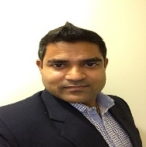
Getting started: day 1 team profiles
RAJAN SANKAR US MULTI SOLUTION ARCHITECT
TARUN SAHA
CDP ARCHITECT
20+ years of success delivering complex business and technology solutions to Fortune 500 clients and other large organizations across multiple industries.
Exclusive focus for the past 10 years on Digital technology, including Digital Strategy, Content Management, and Web Development.
Before joining Cognizant, Rajan was a Principal Architect at Indian Based Technology Service Industry focusing on Content Management and Collaboration solutions.
Tarun has 15+ years of experience years of Master Data Management Experience. Specializing in Data Quality, Data Governance, Customer Data Platform, Enterprise Architecture, Data Quality & Master Data Management Strategy for Customer, Product, Vendor, Supplier, Location etc.
Tarun is Bachelor’s degree in Information Technology. He is having Technical expertise on Informatica MDM – IDQ – EDC – Axon - PIM, Reltio etc.
BACKGROUND
Content Management Systems (Adobe, Vignette)
Adobe Campaign Management
Portal (Epicentric, Vignette, OpenText).
Technology Experience
Microsoft Dynamics AX ERP
Microsoft Dynamics NAV ERP
ERP Implementations
Six Sigma
EXPERTISE

Slide 40
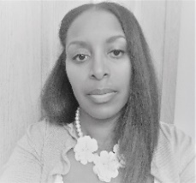

Getting started: day 1 team profiles
KEISHA KNIGHT ADOBE FUNCTIONAL CONSULTANT
SAMER YADAV
DAM ARCHITECT
20+ years of experience in marketing and IT consulting
Strategy consultant focused on digital content & asset management, omnichannel user experience and e-commerce. Keisha has experience working as a functional SME, Business Analyst, Product Owner and Project Manager.
Experienced in Adobe AEM, DAM and Campaign
Education: MBA, University of Florida, Strategy BSFS, Georgetown University, International Political Economy & Latin American Studies
15+ years of experience in Solution Architecture, Design with various DAM implementations, Expertise in application integrations with DAM ,program management and onsite-offshore delivery models.
Experienced professional in Cloud Based Architecture(AWS) and Design for DAM implementation using SaaS Model.
Experienced professional in Requirements Analysis, solution architecture/design ,data migration, data analytics, data modelling.
Domain knowledge in Media/Entertainment, Publishing, Supply Chain and logistics , Manufacturing, Consumer Goods, Retail Industries.
Certifications: Adobe AEM Architect 6.x, Oracle Java Certified, Digital Marketing Certified Associate and Nuxeo
BACKGROUND
Digital Asset Management
Business Analysis
Marketing Operations
Digital Strategy
Content Management
Omni-Channel Marketing
E-commerce
UX & Customer Journey Mapping
Digital Asset Management
Cloud Based Architecture
Requirements analytics
Data modelling
EXPERTISE

Slide 41

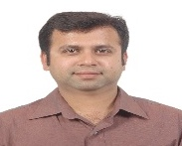
Getting started: day 1 team profiles
RAJESH SHETTI
SOLUTION ARCHITECT
NIKHIL R.
FUNCTIONAL CONSULTANT
Broad range of both Information Technology and Operations Management experience
25 years in-depth experience in supply-chain and Professional Services.
Proven track record in the design and delivery of supply-chain strategies, business processes, and ERP solutions; which achieve best-in-class performance in cost, lead-time, and efficiency
Nikhil over 17 years of overall work experience including 6 years in Dynamics AX and NAV, in the Supply Chain Management (SCM), and a core domain experience in a manufacturing industry. Nikhil has a strong experience in the various modules of AX like Manufacturing, Production, Inventory, Purchase, Sales, etc. I have extensive experience in consultancy for implementing ERP - Microsoft Dynamics AX, NAV, Handling client interaction for requirement gathering, mapping business requirements (As-Is & To-Be Analysis) and preparing scope of implementation and conducting GAP analysis, preparing the Functional Requirements
BACKGROUND
Dynamics 365
Solution Architecture
Project Management
Logistics
Supply Chain Collaboration
Procurement
Manufacturing
Technology Experience
Microsoft Dynamics AX ERP
Microsoft Dynamics NAV ERP
ERP Implementations
Six Sigma
EXPERTISE

Slide 42

Getting started: day 1 team profiles
DIPANKAR BASU ADOBE CAMPAIGN ARCHITECT
15+ years of experience in customer engagement, including marketing campaign management, resource management, cross-channel execution and digital analytics
BACKGROUND
CRM marketing technologies – Adobe, Salesforce, Eloqua, Marketo, Unica
Solutioning and prototype building, conducting application demo & presentations
Developing solution architecture, capacity & blueprint for on-prem, hybrid & SAAS
EXPERTISE

Slide 43
Enabling Harmony
With the Foundation built, we will implement the Harmony specific use cases into the Walgreens CDP, create new APIs, and implement & configure the new OMS

Slide 44
OVERCOMING KEY CHALLENGES
Retail Pharmacy is the heart of WBA’s business and its greatest asset, but a challenge to understand and evolve.
Cognizant has the deepest expertise with WBA’s Retail Pharmacy business in the world, and have worked together during the past five years to evolve a high-risk, near end-of-life, platform into a thriving growth platform enabling WBA to scale its business
Patient data and communication is critical – Cognizant built and supports OWG, the source of customer data and preferences, and knows how to securely leverage that data
Our unmatched expertise in your complex current state expertise enables us to be productive on day one to deliver against your timelines
© 2020
44

Slide 45
OVERCOMING KEY CHALLENGES
OMS is a mission critical platform that will change & differentiate the pharmacy CX.
We’ve done 100+ Legacy to Dynamics 365 transformation engagements and have developed 30+ accelerators that reduces delivery time by 15%
As WBA’s primary Digital partner WBA and Cognizant co-developed the current OMS, support it for Walgreens.com and recently extended it to Boots.com
We know your Digital platforms and systems inside and out, both in Walgreens, where we helped build the .com business from scratch and have evolved over the past 10 years, and at Boots where we are building out the future of Digital as part of DHP

Slide 46
Harmony is about building a nextgen frictionless digital pharmacy experience
ENHANCE CDP FOUNDATION
ENABLING THE PHARMACY LIFECYCLE
“Persist” current state of Harmony
“Centralize” to enable customer insights
Welcome the Customer
Localized Messages with pharmacy details
Customer Personalization
360 View of the Customer
BUILD DECISION WORKBENCHES
Seamless Journey
Dynamic Experiences
“Future ready” customer engagement system
“AI/ML enabled” integrated system
Build Loyalty & Cross-Sell
Summarize & Optimize

Slide 47
To do so, we’ll need a holistic view of Walgreens’ customers
WE’LL IMPLEMENT DYNAMICS CI TO CONSOLIDATE WALGREENS’S DATA AND ENABLE CUSTOMER 360
Data Sources
CDI
Next Booking
Ratings & Reviews
Response for Campaigns
CPM
Order Frequency
Channel Preferences
Order
History
IC+
One Walgreens
Fulfillment channels
Segmentation
Customer Data Platform – Microsoft CI
Next visit indicator
Epsilon
Available Offers
Birthday/ Anniversary details
Purchase Data
ACAP
Contact Details
Online transactions
Loyalty enrollment details
Response

Slide 48
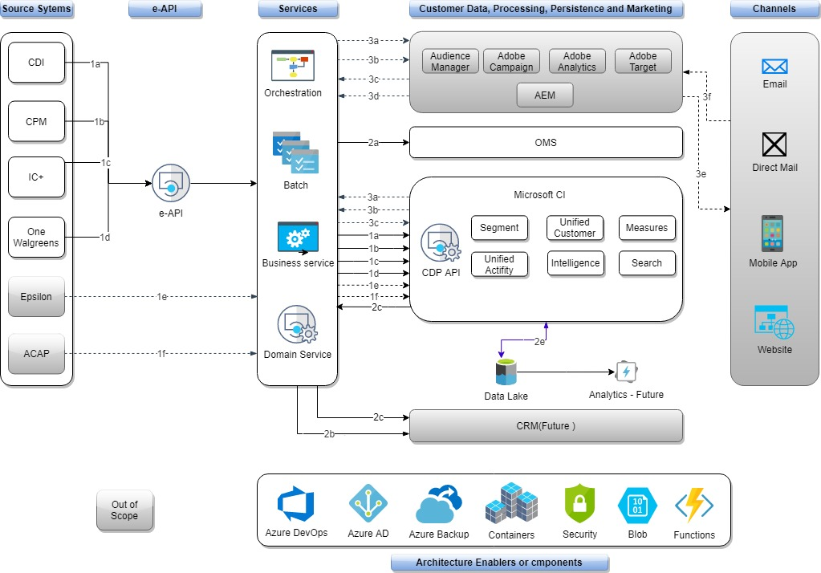
What we’re going to build: Harmony’s technical architecture
Required for Harmony
1a: CDI - Customer address & demographic data send to CI via service layer (batch)
1b: CPM - Rx Notification Consent data send to CI via service layer (batch)
1c: IC+ - Rx Fulfillment events, Store pickup info send to CI via service layer (batch)
1d: One Walgreens - Rx Insurance and payment details send to CI via service layer (batch)
2a: OMS Sales order transactions (create, modify, cancel, delete)
2b: Pharmacy order status (real time)
2c: Customer demographic and preferences data from CI via domain services (real time)
2d: CI data stored in DLS Gen2 storage
Not required for Harmony
1e: Epsilon Loyalty and digital customer details send to CI via service layer (batch)
1f: ACAP-Customer profile, segmentation predictive model scores from Adobe Analytics send to CI via service layer (Batch)
3a: CI send segment details to adobe audience manager via service layer every 24 hrs (batch)
3b: CI send profile data to Adobe Campaign manager via service layer (batch)
3c: Batch load of Tracking details from Adobe campaign to CI via service layer -every 6 hours (batch)
3d: Adobe Analytics data send back to ACAP
3e: Marketing details shared to customers
3f: Analytics data collected from customers

Slide 49
Enabling Harmony: track sprint activities & dependencies
Onboard
Build & QA
Hardening
Go Live
Sprint 1 | Sprint 2 | Sprint 3 | Sprint 4 | Sprint 5 | Sprint 6 | Sprint 7
Full team onboarding System design Team environment setup Discuss with Product Owner and prioritize requirements Firm up Sprints and timelines, POD teams Create Backlog items for Sprint 1 | Unifying Customer Data,& Setting up Search & Filter Index Setting up Relationships, & Activities OMS : D365 F&O Configuration Build - Domain API - CDI, CPM CI Data Ingestion- CDI, CPM CI Profile Unification-CDI, CPM | Domain API - IC+, OneWalgreens Data Ingestion CI : IC+, OneWalgreens Profile Unification CDI, CPM OMS : D365 F&O - Item & Sub-Master and Sales Order Setup | Outbound, Unified Profile, OMS: D365 F&O : Develop Integration with inbound and outbound Service Bus – Topic creation for OMS Create Unified Profile API CI Measures/Segments Configuration (Set 1) | Data Access for Downstream Apps Domain API - RT API for Harmony CI Outbound Integration CI Measures/Segments (Set 2) Activities, Segment, Export, Refresh, D365 : Sales Order Lookup API , D365 - Data Sync | Regression Testing Perform upstream to Domain to CI/OMS system flow Validate failure scenarios Performance Testing with production/near production volumes UAT Support | GO – Live Production rollout Planning Production Deployment ( through CI/CD Pipeline) and Initial Data Load to CI Hyper Care Support
Environment access for developers Guiding Principles about the Data Schema for Customers, Transactions an Attributes | CDI, CPM – eAPI API availability Conceptual Data Model for CI Availability of Source Data - CDI, CPM Availability of environments for development & in-sprint testing | Availability of OneWalgreens/IC+ eAPI contract & API readiness OMS – Service Bus Access Availability of Source Data -IC+, OneWalgreens Review and Confirm Test Plan, and test cases. Availability of environments for development & in-sprint testing | Segmentation and KPI’s to be configured based Campaign Management Availability of environments for development & in-sprint testing | Segment, Activities, KPI – Parameters (based on campaign requirement) SIT environment Availability of environments for development & in-sprint testing | Coordinate with upstream and downstream systems for User Acceptance Test flows & Sign Off Availability of testing environment | Cut Over Plan Signoff Availability of Production Environment, Source System readiness
// ACTIVITIES
// DEPENDENCIES

Slide 50
Timeline view of the Harmony track
APRIL |  | MAY |  |  |  | JUNE |  |  |  |  | JULY |  |  |  | AUG |  |  |  |  | SEP
20 | 27 | 4 | 11 | 18 | 25 | 1 | 8 | 15 | 22 | 29 | 6 | 13 | 20 | 27 | 3 | 10 | 17 | 24 | 31 | 7 | 14
All
Dynamics F&O
CI
API
S4
S5
S6
S7
S8
Upstream to CI/OMS System Flow
Regression & Performance Testing
UAT Support
Validate Failure Scenarios
S3
Story Elaboration
Backlog Grooming
System Design
Env. Setup
S9
S10
Launch Planning
S11
Launch
Hypercare
S4
Configuration Build - Domain API - CDI, CPM
S5
Item & Sub-Master and Sales Order Setup
S6
Outbound, Unified Profile–Integrate with In and Outbound
Service Bus–Topic creation
S7
Activities, Segment, Export, Refresh - Sales Order Lookup API , D365 - Data Sync
S8
S3
S9
S10
S11
S3
S4
Unify Customer Data, Search & Filter Index
Setup Relationships & Activities
Data Ingest-CDI,CPM
Profile Unif-CDI, CPM
S5
Data Ingestion: IC+, OneWalgreens, ACAP
Profile Unification CDI, CPM
S6
Measures/Segments Configuration
S7
Data Access for Downstream Apps
Outbound Integration
Measures/Segments (Set 2)
S8
S9
S10
S11
S3
S4
Unify Customer Data
S5
IC+, OneWalgreens, ACAP (Profile)
S6
Create Unified Profile API
S7
RT API for Harmony
S8
S9
S10
S11

Slide 51
Enabling Harmony: pod structure
BASED ON EXECUTION PLAN, THE HARMONY POD WILL BE DIVIDED INTO MULTIPLE PODS TO STREAMLINE DELIVERY
 | Program pod | Harmony execution pod
Product Manager
Enterprise Architect
Azure Cloud Architect
OMS Architect
Scrum Master
CDP Architect
Integration Lead
Functional Consultant
Technical Consultant
CDP Lead
CDP Developer
Analytics Developer
Full Stack/DevOps Engineers
Quality Engineers*
legend
ONSHORE
OFFSHORE
*Quality engineering includes performance, security, automation, and functional testing.
(x11)

Slide 52
Scope & assumptions: Harmony track – 1 of 2
Scope Area | Scope/Assumption
CI - Environment | WBA will engage Microsoft to provide CI as SaaS solution Walgreens and Boots will have separate CI instances and Data Lakes WBA will procure necessary Tenants on Microsoft Cloud along with respective tools before start of the engagement Number of environments will be 4- Dev, QA, UAT/Pre-Prod and Production
CI -Data Source | Harmony - CDI, CPM, IC+, OneWalgreens
CI - Data Model | Entities: Customer Demographics, Consent & Preferences, Rx Pickup data, Insurance & Payment details
CI -Data Ingestion | Only structured data and Batch mode only for all the sources. Ingestion will be carried out through OOTB connectors; no custom ingestion method is considered Only OOTB transformation rules are considered Total number of attributes per source < 100
CI - Unification | Unification of profile will be carried based on common IDs provided by the source systems Unification of activity data will be carried out through IDs Probabilistic matching is not considered and no real time matching is considered as part of scope
CI - Data Quality and Enrichment | Integration with any enrichment source/tool is NOT considered Data cleansing & standardization will be achieved through CI OOTB capabilities and will be limited to basic cleansing and standardization, such as case conversion, noise character/white space removal, etc.
CI -Analysis/Insight | Number of Static & Dynamic Segments per CI implementation will be 8-10 Number of Customer & Business Measures per CI implementation will be 8-10 All the required segmentation, KPIs/Measures can be configured leveraging the CI OOTB capabilities No external / custom machine learning models are considered (e.g. building models in Azure ML and integrate them with CI) Inference of NBA, NBO is not in scope for CI

Slide 53
Scope & assumptions: Harmony track – 2 of 2
Scope Area | Scope/Assumption
CI - Outbound Integration | Harmony Business Logic tier will be integrated through Real Time services via Domain APIs; MS CI OOTB APIs will be invoked by the Domain APIs to access Customer Demographic and Preference data and will be using canonical model for exposing the data from CI.
CI to Data Lake Integration | Integration with Walgreens Data Lake (Read and Write) will be carried out via OOTB connectors
CI - Reporting | Reporting is out of scope on CI
CI - Performance | Performance of the CI will be evaluated based on volume of the incoming data for delta loads. Have not estimated anything on Performance metrics as we assumed the delta load for every 6hrs would be less.
System API Layer | Assumption is to have System API layer to be available with source system specific data pipes before start of the engagement
Quality of Source Data | Assuming the quality of data is good for CI ingestion for Matching. Data Profiling Reports will determine the health of data. Effort of development will vary based on Data Profiling reports shared by WBA.
OMS | Scope of OMS system is to create only below functionalities. Create Sales Order, Update Sales Order (RX, RX#),RX Lookup (Order number RX Number),Order Lookup (Order Number),Order Lookup (Customer ID) Sales order Domain API will send order details to OMS via Azure service Bus. Further processing is done by F&O system Eg. Pick up Order details ,send to downstream systems and receive response
eAPI | We assume all e-API's required to implement the use cased mentioned in the RFP are already exist, if not it will impact project timelines E-API interface specification document made available during design phase of Domain API Layer Design and development of e-Api is not part of the RFP Scope
Domain API | Exact list of Domain API needs to created and its input and output parameters determined during foundation phase
 | Initial data load of Customer demographics into CI is not done through Domain API Layer
 | Inbound Data To CI : Domain API layer will get the data from Source systems through e-API and upload the file in Azure blob storage that will be consumed by CI
 | WBA team needs to provide Identify Access management(IAM) provider details to secure Domain API's using JWT Tokens.
 | WBA will provide Azure Access credentials to set up components and services used for this RFP.

Slide 54

Implementing a nextgen CDP, fueled by GA360 behavioral data
SUCCESS STORY
For a leading life sciences client
THE STORY
WE DELIVERED
The client needed to capture data on visitor journey and visitor engagement and conversion at hit level, process it and then connect it to downstream systems for remarketing and reporting in dashboards
The client currently collects user data across its several digital properties in silos
Tealium IQ for data collection from multiple digital properties across geographies in Google Analytics 360.
Data collected in Tealium and transferred real time to Adobe Campaign to trigger remarketing email campaign.
Tealium Eventstream and Audience stream being set up for connecting event data & audience data to downstream systems for personalized remarketing and reporting/dashboarding.
TECHNOLOGIES
LEVERAGED
Tealium IQ, Tealium Eventstream, Tealium Audience stream
360*
Google Analytics 360
Simplified, customized marketing with cross-functional integration
View of customer
Real time data collection and transfer using Tealium customer data platform
Integrated with cloud ecosystem
Increased Page Views per Session caused a lift in Ad Revenue
Notes:
Sanofi or GSK

Slide 55
Transforming supply chains using Microsoft Dynamics 365 F&O
SUCCESS STORY
For a leading healthcare company
THE STORY
WE DELIVERED
The client currently leveraged McKesson system to manage the supply chain and finance functions of their industry. The application supports 12 business units based on U.S. geography with 100+ users leveraging the system
The current system lacked the robustness and scale and had low user adoptability.
The key objective of the client was to identify a preferred ERP solution that was robust, scalable, had familiar UI and catered to their business needs preferably hosted on cloud.
Product Assessment exercise was carried out for 6-weeks with recommendation report and implementation Roadmap.
Design and development phase for the following functionalities:
Master Planning
Procure-to-pay
Inventory Management
Financial/ GL management
Accounts Payable and Receivables
Vendor punch-out functionality
Interfaces with legacy applications
5 years historical data migration
User Test case creation and providing user training leveraging “Train-the-trainer” approach is currently in progress
TECHNOLOGIES
LEVERAGED
D365 for Finance & Operations
GL, Bank Management, AR, AP, Fixed Assets, Inventory, Procurement, Sales, MP
360*
Simplified, customized marketing with cross-functional integration
View of customer
Faster time-to-market due to higher use of OOB functionalities within D365
Highly scalable and robust infrastructure provided by Microsoft cloud
Approx. 30% reduction in license cost
Notes:
Sanofi or GSK

Slide 56
Enabling Wonder Woman
Built on the same foundation as Harmony, but in its own instance, we will implement the Wonder Woman specific use cases into the Boots CDP and enable it through APIs.

Slide 57
OVERCOMING KEY CHALLENGES
CI is a nascent technology, yet the foundation of your personalization program.
Cognizant has the largest, most mature Data & Analytics practice in the world and have implemented multiple CDP technologies – we’ve seen it all
We are a $1B+ Microsoft partner, and will work closely with Microsoft to help prioritize the CI roadmap based on WBAs needs
Your timeline is aggressive - we know what data you have and where it is today - we’re best positioned to help you transform to future state without wasting time on KT/Discovery

Slide 58
Wonder Woman is about equipping Boots Beauty associates with the data they need to drive breakthrough customer interactions
INTEGRATING, ENRICHING, AND USING THE “CUSTOMER CONTEXT” TO ORCHESTRATE BEAUTY INTERACTIONS THAT ARE TARGETED AND RELEVANT FOR EACH CUSTOMER, ACROSS TOUCHPOINTS
ENHANCE CDP FOUNDATION
ENABLING THE IN-STORE BEAUTY EXPERIENCE
“Persist” current state of Harmony
“Centralize” to enable customer insights
Welcome the Customer
Efficient search
Understanding Customer Needs
360 View of the Customer
BUILD DECISION WORKBENCHES
Seamless Journey
Dynamic Experiences
“Future ready” customer engagement system
“AI/ML enabled” integrated system
Build Loyalty & Close the Sale
Summarize & Optimize

Slide 59
Like with Harmony, we’ll need a holistic view of Boots’ customers
Data Sources
CDI
Next Booking
Ratings & Reviews
Response for Campaigns
CPM
Order Frequency
Channel Preferences
Order
History
IC+
One Walgreens
Fulfillment channels
Segmentation
Customer Data Platform – Microsoft CI
Next visit indicator
Epsilon
Available Offers
Birthday/ Anniversary details
Purchase Data
ACAP
Contact Details
Online transactions
Loyalty enrollment details
Response

Slide 60
Enabling Wonder Woman: activities & outputs
Onboard
Build & QA
Hardening
Go Live
Sprint 1 | Sprint 2 | Sprint 3 | Sprint 4 | Sprint 5 | Sprint 6 | Sprint 7
Full team onboarding System design Team environment setup Discuss with Product Owner and prioritize requirements Firm up Sprints and timelines, POD teams Create Backlog items for Sprint 1 | Build Domain API – SVOC Build data ingestion – SVOC CI Profile unification - SVOC | Develop Domain API – SAP CRM, Mobile Server Implement CI Data Ingestion: Mobile Server Implement CI Profile Unification: SAP CRM, Mobile Server | Develop Domain API - CoreMetrics, Wonder Woman SQL DB Implement CI Data Ingestion: CoreMetrics, Wonder Woman SQL DB CI Measures/Segments Configuration (Set 1) | Domain API Integration for Customer Demographics & Preferences for Wonder Woman Domain/Batch Ingestion – Data feed from Data Lake (POS) CI Outbound Extract Generation for PII and non-PII Data CI Measures/Segments Configuration (Set 2) | SIT Regression Testing Perform upstream to Domain to CI system flow; Support CI to Wonder Woman RT Integration testing Validate failure scenarios Performance Testing with production/near production volumes UAT Support | GO – Live Production rollout Planning Production Deployment ( through CI/CD Pipeline) and Initial Data Load to CI Hyper Care Support
Environment access for developers Guiding Principles about the Data Schema for Customers, Transactions an Attributes | Existing API availability Availability of source data – SVOC Availability of environments for development & in-sprint testing | Existing System API availability – SAP CRM, Mobile Server Availability of Source Data - SAP CRM, Mobile Server Availability of environments for development & in-sprint testing | Availability of environments for development & in-sprint testing | Wonder Woman and CI Real Time service contract Availability of environments for development & in-sprint testing | Coordinate with upstream and downstream systems for User Acceptance Test flows & Sign Off Availability of testing environment | Cut Over Plan Signoff Availability of Production Environment, Source System readiness
// ACTIVITIES
// DEPENDENCIES

Slide 61
Timeline view of Wonder Woman track
APRIL |  | MAY |  |  |  | JUNE |  |  |  |  | JULY |  |  |  | AUG |  |  |  |  | SEP
20 | 27 | 4 | 11 | 18 | 25 | 1 | 8 | 15 | 22 | 29 | 6 | 13 | 20 | 27 | 3 | 10 | 17 | 24 | 31 | 7 | 14
S4
S5
S6
S7
S8
Regression & Performance Testing
UAT Support
Validate Failure Scenarios
All
CI
API
S3
Story Elaboration
Backlog Grooming
System Design
Env. Setup
S9
S10
Launch Planning
S11
Launch
Hypercare
S4
Build data ingestion – SVOC
Profile unification - SVOC
S5
Data Ingestion: Mobile Server
Profile Unification: SAP CRM, Mobile Server
S6
Ingestion: CoreMetrics, Wonder Woman SQL DB
Measures/Segments Configuration
S7
Domain/Batch Ingestion – Data feed from POS Data Lake
Outbound Extract Generation PII/non
S8
S3
S9
S10
S11
S4
Build Domain API – SVOC
S5
Develop Domain API – SAP CRM, Mobile Server
S6
Develop Domain API - CoreMetrics, Wonder Woman SQL DB
S7
Domain API Integration - Customer Demographics & Preferences
S8
S3
S9
S10
S11

Slide 62
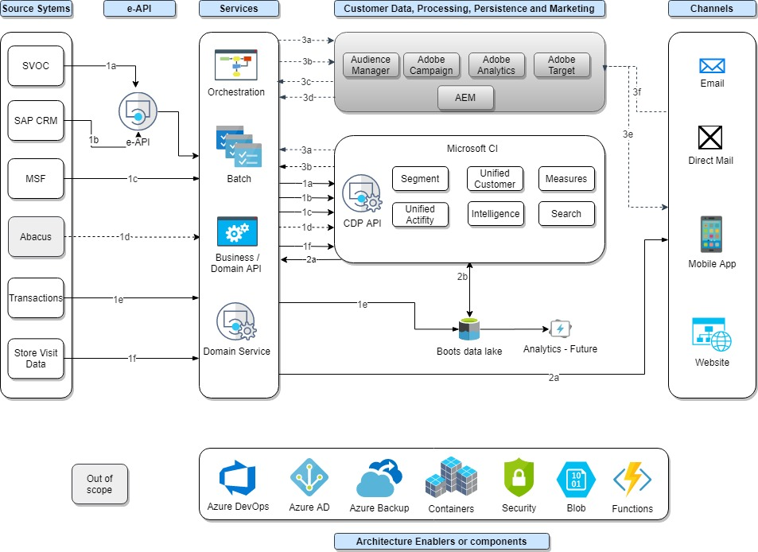
What we’re going to build: Wonder Woman’s technical architecture
Required for Wonder Woman
1a: SVOC - Customer and demographic details send to CI via service layer (Batch)
1b: SAP CRM - Loyalty information send to CI via service layer (Batch
1c: MSF- available offer details send to CI via service layer (Batch
1e: Transactions-Batch load of Purchase data from POS/Boots.com to Boots data lake
1f: Store visit details are pulled from Clienteling app DB(Azure SQL) from CI via service layer (batch)
2a: iPad app reads customer 360 details from CI (real time)
2b: CI data stored in Boots Data Lake
Not required for Wonder Woman
1d: Abacus data send to CI via service layer (Batch)
3a: CI send segment details to adobe audience manager CI every 24 hrs (batch)
3b: CI send profile data to Adobe Campaign send to CI via service layer (batch)
3c: Batch load of tracking details from Adobe campaign to CI every 6 hours (batch)
3d: Adobe Analytics data send back to Abacus
3e: Marketing details shared to customers
3f: Analytics data collected from customers

Slide 63
Enabling Wonder Woman: pod structure
BASED ON EXECUTION PLAN, THE WONDER WOMAN POD WILL BE DIVIDED INTO MULTIPLE PODS TO STREAMLINE DELIVERY
 | Program pod | Harmony execution pod
Product Manager
Enterprise Architect
Azure Cloud Architect
Scrum Master
CDP Architect
Integration Lead
Functional Consultant
CDP Lead
CDP Developer
Analytics Developer
Full Stack/DevOps Engineers
Quality Engineers*
legend
ONSHORE
OFFSHORE
*Quality engineering includes performance, security, automation, and functional testing.
(x8)

Slide 64
Wonder Woman: scope, assumptions & dependencies
Scope Area | Scope/Assumption
CI - Environment | WBA will engage Microsoft to provide CI as SaaS solution Walgreens and Boots will have separate CI instances and Data Lakes WBA will procure necessary Tenants on Microsoft Cloud along with respective tools before start of the engagement Number of environments will be 4- Dev, QA, UAT/Pre-Prod and Production WBA will engage Microsoft to provide CI as SaaS solution
CI -Data Source | Wonder Woman: SVoC, SAP CRM,Mobile Server Framework, Wonder Woman SQL DB
CI - Data Model | Entities Wonder Woman: Customer Demographics, Loyalty Points, Available Offers, Offer on Cards, Past Purchases from POS & Boots.com, Online Activity
CI -Data Ingestion | Only structured data and Batch mode only for all the sources.
 | Ingestion will be carried out through OOTB connectors; no custom ingestion method is considered
 | Only OOTB transformation rules are considered
 | Total number of attributes per source < 100
CI - Unification | Unification of profile will be carried based on common IDs provided by the source systems
 | Unification of activity data will be carried out through IDs
 | Probabilistic matching is not considered and no real time matching is considered as part of scope
CI - Data Quality and Enrichment | Integration with any enrichment source/tool is NOT considered
 | Data cleansing & standardization will be achieved through CI OOTB capabilities and will be limited to basic cleansing and standardization, such as case conversion, noise character/white space removal, etc.
CI -Analysis/Insight | Number of Static & Dynamic Segments per CI implementation will be 8-10
 | Number of Customer & Business Measures per CI implementation will be 8-10
 | All the required segmentation, KPIs/Measures can be configured leveraging the CI OOTB capabilities
 | No external / custom machine learning models are considered (e.g. building models in Azure ML and integrate them with CI)
 | Inference of NBA, NBO is not in scope for CI

Slide 65
Wonder Woman: scope, assumptions & dependencies
Scope Area | Scope/Assumption
CI - Outbound Integration | Wonder Woman Business Logic tier will be integrated through Real Time services via Domain APIs; MS CI OOTB APIs will be invoked by the Domain APIs to access Customer 360 data and will be using canonical model for exposing the data from CI.
CI to Data Lake Integration | WBA will provide the necessary clarifications on ADLS during Discovery/Solution Blueprinting phase, currently we have assumed CI will be integrated into BOOTS data lake using ADLS this will be validated and confirmed with WBA
CI - Reporting | Reporting is out of scope on CI
CI - Performance | Performance of the CI will be evaluated based on volume of the incoming data for delta loads. Have not estimated anything on Performance metrics as we assumed the delta load for every 6hrs would be less.
System API Layer | Assumption is to have System API layer to be available with source system specific data pipes before start of the engagement
Quality of Source Data | Assuming the quality of data is good for CI ingestion for Matching. Data Profiling Reports will determine the health of data. Effort of development will vary based on Data Profiling reports shared by WBA.
e-Api | We assume all e-API's required to implement the use cased mentioned in the RFP are already exist, if not it will impact project timelines
e-Api | E-API interface specification document made available during design phase of Domain API Layer
e-Api | Design and development of e-Api is not part of the RFP Scope
Domain API | Exact list of Domain API needs to created and its input and output parameters determined during foundation phase
Domain API | Inbound Data To CI : Domain API layer will get the data from Source systems through e-API and upload the file in Azure blob storage that will be consumed by CI
Domain API | WBA team needs to provide Identify Access management(IAM) provider details to secure Domain API's using JWT Tokens.
Domain API | WBA will provide Azure Access credentials to set up components and services used for this RFP.

Slide 66
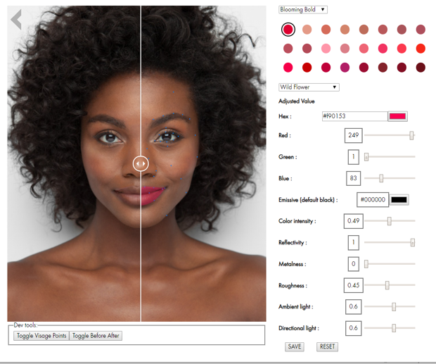
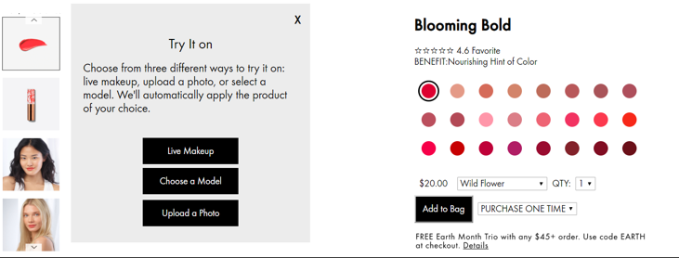

Transforming the Beauty CX using personalization & innovation
SUCCESS STORY
For a leading Beauty brand
THE STORY
WE DELIVERED
The client wanted to find a way to increase online sales of lipstick with a new customer experience. Knowing that selling makeup (lipstick) online is inhibited by the inability to try it on, they asked Cognizant to help them develop a solution – Virtual Try-On – to emulate the in-store experience.
Design - Built a 3D mask that is placed over the face of the subject and maps on the keypoints extracted by the facial tracking program.
Machine Learning – Technology to detect the face and the keypoints where the 3D mask would be placed.
Frontend - An app, using the 3rd party facial tracking technology first and then our custom made technology & the 3D mask, the lipstick is applied using several scenarios for data input
Demonstrated ability to bring together virtual reality technologies and new customer experience that could be deployed on the brand’s website, in a mobile app or and in-store kiosk

Slide 67
Enabling Walgreens & Boots MarTech
Building from the Adobe playbook defined during the Foundation Phase, we will develop the Adobe platform, integrate it into Walgreens’ and Boots’ existing Adobe stacks, enable the use cases in CDP, and build the APIs needed to bring it all to life for handoff to the Campaign Execution team.

Slide 68
OVERCOMING KEY CHALLENGES
AEC is your CX platform of the future, but it isn’t a check-the-box integration. Multi-solution delivery is complex & challenging
We’ve done more complex, multi-solution Adobe implementations than anyone in the world
Quality as speed is what we do – we’ve been recognized by Adobe as their “Delivery Quality Partner of the Year” two years in row in both the US & the UK
Between Cognizant in the US and netcentric in the UK we have one of the deepest Adobe talent pools in the world between
© 2020
68

Slide 69
Our solution is focused on delivering a scalable marketing technology foundation that enables personalized omnichannel experiences for WBA’s customers globally, implemented locally
CORE DELIVERY EXCELLENCE
Enabling Channel & Marketing strategy for WBA
Enabling best practices across MarTech capabilities
Metrics & KPIs driven Delivery
SCALABLE DIGITAL FOUNDATION
Global MarTech solution blueprint that is localized for Walgreens & Boots
Enable scalable architecture foundation
Enable foundational decisions for Pharmacy use cases (HIPAA compliance)
DIGITAL INNOVATION
Enable templatization for efficiency
Rich set of Adobe Experience Cloud accelerators
Business value management

Slide 70
Applying a Playbook approach to enable global consistency with Brand flexibility
LEVERAGING CORE TEMPLATES WITH MARKET SPECIFIC LOCALIZATIONS TO DELIVER AN ACCELERATED AND SCALABLE PLATFORM
CORE ELEMENTS
(Template or Core Model)
LOCAL ELEMENTS
CORE (BRAND)
TEMPLATE CREATION
Adobe Master
Data
Localized Content,
Assets, Journeys
Market specific
Rules and Regulations
LOCAL (Brand/ Market)
TEMPLATE CREATION
Define the channel wide brand requirements
Create the core brand template(s)
Create Data Models
Setup Security Principles
Start with core template
Add the market specific data, content etc.
Incorporate Local Regulatory Compliances
Preference Management Processes
Core Structures
and Settings
Core Content
and Assets
Market specific Process
Brand Template
Setup in Adobe
Core Business
Rules
Core
Integrations

Slide 71
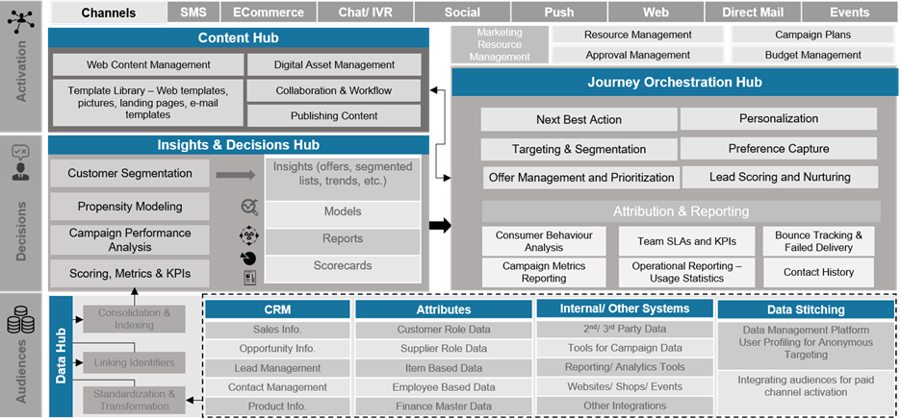
Enabling personalization marketing
PLAYBOOK FOR BOOTS & WALGREENS

Slide 72
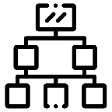



What we’ll need to do to be successful
We HAVE INCLUDED a holistic scope we believe is critical – including addressing gaps we identified in the rfp.
DATA
AND CDP
CAMPAIGN PLATFORM DECISION
CAMPAIGN PARTNER ENABLEMENT
ENTERPRISE CAMPAIGN PLANNING
CDP Readiness: Availability of data from CDP (including data from ADLS to CDP)
CDP being decoupled: The plan here assumes synergies between Cognizant executing Adobe & CDP efforts
Deciding on Campaign platform for WBA long term, beyond FY 2020
Considerations for HIPAA & Adobe licensing
Platform readiness to enable on time channel activation
Handover & platform training
Need for orchestrated campaign planning across agencies & WBA stakeholders
Platform stack for Campaign Planning does not exist in current plan shared by WBA
IN RFP, SCOPED
RFP GAP, NOT SCOPED

Slide 73
Data and CDP
THE CHALLENGE
Data and CDP readiness is critical to enable timely delivery of the Adobe platform (importantly Adobe Campaign & Adobe Audience Manager).
HOW WE SEE IT
CDP’s inability to enable data for Walgreens & Adobe use cases will have a ripple effect:
Design Approach – possible direct integrations from current data sources to Adobe
Data Quality & Governance – this may need to be customized for Adobe consumption
Current synergy is accounting for data architecture blueprinting throughout CDP & Adobe build out during foundation. Decoupling of this effort will have an impact on delivery.
THE IMPACT
Project Schedule, Project Cost, Solution Design

Slide 74

Campaign platform decision
THE CHALLENGE
Adobe’s Campaign (ACC & ACS; except Marketo) solutions are not HIPAA compliant. While this may not be a consideration for FY 20, the foundational design should account for pharmacy use cases scalability.
HOW WE SEE IT
Solution options to enable Adobe architecture to support use cases:
CAMPAIGN STANDARD (FOR NON PHARMACY) & MARKETO (FOR PHARMACY)
Limited PII email uses HIPAA Complaint delivery
Fully on Adobe cloud with other Adobe Marketing Products except AEM
Custom history sync between ACS and Marketo
CAMPAIGN CLASSIC WITH ADOBE MTA (FOR NON PHARMACY) & MARKETO (FOR PHARMACY)
Segmentation engine being on Azure can access other data sources via FDA
Deliverability and reputation managed by Adobe
Custom history sync between ACC and Marketo
CAMPAIGN CLASSIC WITH 3RD PARTY MTA
SMTP relay via HIPAA complaint ESP
Individual email with custom headers as a SMTP package sent to ESP
Custom integration to get spam, un-subscription feedback from email provider via ESP
THE IMPACT
Project Schedule, Project Cost, Solution Design, Product licensing

Slide 75
Campaign platform decision
ADOBE Campaign options
CAMPAIGN CLASSIC VS STANDARD
ACS VS MARKETO
Available on Azure with mid-sourcing
Easy access to other DB via FDA
Availability of native offer module
Slow to get new features and updates
OTB SOAP APIs only
Completely on Adobe Cloud
Robust API Structure via REST
Modern UI using HTML5
Connector for Azure BLOB integration
More aligned to B2C use cases
Robust transactional messaging
Connector for AA, AEM, AT & AAM
Not HIPAA complaint
More aligned to B2B use cases
Easy integration with 3rd party service via Launch Point apps/solutions
AA and AEM integration via launchpoint
AT and AAM needs custom integration
SINGLE VS MULTIPLE DELIVERY ROUTING
ADOBE DELIVERY VS SMTP RELAY
One consolidated IP warming plan
Cost effective reputation management
No campaign level IP affinity management overhead
Different IP for PII vs non-PII email
ESP SPAM/Unsub feedback impacts only specific routing
Separate routing for marketing vs transactional communication
Delivery and reputation managed by Adobe
OTB Connector for integration
Fully supported by Adobe
PII Data on Adobe cloud
Delivery via internal or third-party SMTP
HIPAA and BAA compliant
Mix of OTB features and custom code
Not recommended by Adobe
Custom delivery feedback ingestion
MOBILE SDK COMPARISON
Neolane SDK: Supported by Campaign classic via Xcode and Androind Studio
Adobe Mobile SDK 4: End of support Q3 2020
Experience Platform SDK: Latest with most inclusive features. Integrates with Campaign (ACC & ACS), Target, Analytics and Audience Manager. Fully integrated with device location via Places Extension

Slide 76






Campaign partner enablement
HOW we’ll prepare the organization for campaign execution with adobe training
TRAINING ANALYSIS | TRAINING DESIGN | TRAINING MATERIALS | TRAINING DELIVERY | USER ACCEPTANCE SUPPORT
Discuss training needs with key WBA campaign partners Identify any roadblocks to training/ Blackout dates | Finalize training approach Define Roles and Responsibilities Define the Key areas where training is needed | Draft training material specific to each Region and sub-region on the new marketing automation platform, onboarding process and best practices Review with WBA SMEs and incorporate feedback | Train the Super Users Provide recommendations to WBA team for future training needs | Provide on demand support and recommendations for any system integrations issues to business users and SMEs Relevant resources to assist with execution of test plan
DELIVERABLES
Adobe Playbook (Process workflows) and Training Doc: Up to 10 artifacts
20 hours of In-person training

Slide 77
Campaign partner enablement
Establishing THE GOVERNANCE PLAYBOOK
ACTIVITIES | WBA | COGNIZANT | CAMPAIGN PARTNER | ADOBE
Campaign Brief | C | C | R/A
UX Brief | C | C | R/A | I
HTML Development | C | C | R/A
Data Load | I | R/A | C | I
Platform Readiness | C | R/A | I | C
User Training & Workshop | C/I | R/A | C/I | I
SIT | C/I | R/A | C | I
Campaign / Channel Build | C/I | C/I | R/A | I
UAT | R | R | R/A | I
IP warming | C/I | C/I | R/A | R/A
Key Stakeholders | Marketing/ Brand SMEs, IT SMEs, Content SMEs, Adobe Business Users, | Functional Consultant, Adobe Architect(s), Program Manager, Documentation Specialist, Tester | Campaign Partner team, WBA brand team Assumed: Trained on Adobe stack, but will be transitioned for WBA specific Adobe platform | Adobe Professional Services & Managed Services Team

Slide 78










Enterprise campaign planning (not scoped)
We strongly recommend end to end Campaign Planning to orchestrate intake pipeline, govern review-and-approval of key campaign deliverables and measure across campaigns.
CAMPAIGN PLANNING & RESOURCING
CAMPAIGN EXECUTION MANAGEMENT (PEOPLE & PROCESS)
PROJECT MANAGEMENT, REVIEW & APPROVAL, OPERATIONAL REPORTING
Intake point for all marketing campaigns and related briefs
Single ‘source of truth’ for master campaign timeline / project plan
CAMPAIGN DESIGN
& SETUP
CREATIVE
DEVELOPMENT
CONTENT
PRODUCTION
DEPLOYMENT
& MONITORING
Automatically send newly created WF campaigns & metadata to Adobe Campaign
Link directly to AEM folders or assets in WF briefs / project plans
Push approved creative + campaign metadata into AEM directly from WF
View response metrics from Adobe Campaign directly within campaign record in WF
Serve up tasks from planning tool’s project plan directly within CC
Access final approved assets stored in AEM in WF within context of campaign(s)
Submit creative to planning tool for review
/ sign-off directly from CC
We recommend a platform such as Workfront OR APRIMO with strong integrations to Adobe Experience cloud

Slide 79
OUR PROPOSED TECHNOLOGY SOLUTION
/ Enabling personalization
/ Solution architecture options – classic vs. standard
/ Real time activation via real time collection with CDP
/ Enabling Adobe DevOps
/ Apply Adobe Experience Cloud accelerators

Slide 80
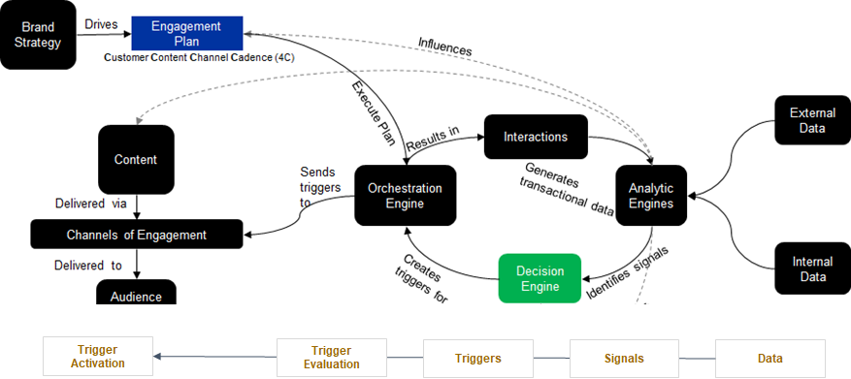
Enabling personalization
Conceptual process flow

Slide 81
Solution architecture
Option A: Campaign classic
We believe Walgreens & Boots can share a common solution blueprint with customization for localization.
Campaign classic provides a legacy, customizable option.
LEGEND
RED: Walgreens specific
BLUE: Boots specific
YELLOW: Tasks/solutions that are part of core CDP program that will impact marketing track
GREEN: Integration functions that will be built as part of core CDP program and will be consumed by Adobe platform

Slide 82
Solution architecture
Option B: Campaign STANDARD
We believe Walgreens & Boots can share a common solution blueprint with customization for localization.
Campaign standard provides a nimble, more modern option.
LEGEND
RED: Walgreens specific
BLUE: Boots specific
YELLOW: Tasks/solutions that are part of core CDP program that will impact marketing track
GREEN: Integration functions that will be built as part of core CDP program and will be consumed by Adobe platform

Slide 83

Enabling real time activation by real time collection with CDP
OUT OF SCOPE | TO ENABLE REAL TIME, YOU’LL NEED TO LOOK AT CI OPTIONS BEYOND MICROSOFT CI
TRUSTED PROFILE MANAGEMENT
REAL-TIME ACTIVATION
Via API, S2S Integrations
STREAMING DATA COLLECTION
Via API, SDK
KNOWN CUSTOMER DATA
CRM
Email
Authenticated Profile
Customer ID
Partner ID
ADVERTISING ECOSYSTEM
Paid Media
Social Media
GOVERNANCE
DATA SCHEMA
Real-time
Customer
Profile
PERSONALIZATION
On-site Personalization
In-app Personalization
UNKNOWN DATA
Behavioral Analytics
Cookie
Device ID
Advertising Data
CUSTOMER SYSTEMS
CRM | Email
Call Center | Data Lake
Open API Destinations
SEGMENTATION
AI / ML
REAL-TIME CDP CAPABILITIES
Data Ingestion
Data Schema
Privacy Service
Real-time Customer Profiles
Data Governance
Identity Service Segmentation Service
Marketing Activation Destinations
Marketer-Focused AI/ML
NOT IN CURRENT PLATFORM ROADMAP

Slide 84



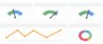
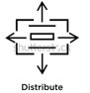


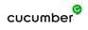






Enabling DevOps for Adobe will be critical to achieving the timeline and building a scalable architecture
Commit code changes
Triggers the code sync on change
Kick of the build
Consume and publish artifacts
SOURCE CONTROL
CONTINUOUS INTEGRATION
CODE BUILD SCRIPTS
NATIVE
CODE
Developers
Load build version
Deploy automation code build and test
VERSION CONTROL
BUILD AUTOMATION
Product
feature backlog
CHECK IN – CHECK OUT
UNIT TEST
PUBLIC AND PRIVATE REPO
CODE ANALYSIS
Analytics
MERGE AND BRANCH
CODE COVERAGE
Product management
Product feature backlog
User experience feedback
Beta Users
ISSUE TRACKING/DOCUMENT REPOSITORY/PROJECT MANAGEMENT
QUALITY
SOURCE CODE
BUILD
CI/CD
CODE QUALITY

Slide 85

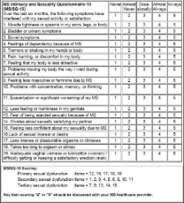
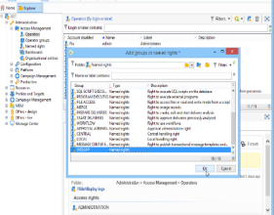
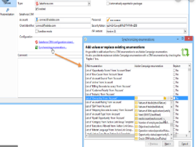
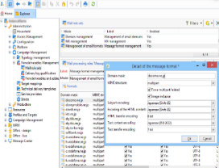






Applying Cognizant Adobe Experience Cloud accelerators to deliver speed and efficiency
PRODUCT
SELECTION
ACCESS MANAGEMENT
DATA
MANAGEMENT
EMAIL
MANAGEMENT
IN-HOUSE TOOLS AND ACCELERATORS
ADOBE AEM CONTENT UPLOAD
MIGRATION FRAMEWORK
SITE ROLLOUT UTILITY
Digital Marketing Capability Checklist/Questionnaire
Automated access rights provision
Automated package export import tool
Real time email trigger/
Email Restriction
Migration kit/
METATAGGER UTILITY
Help customer to do a fit mapping and select the right marketing platform. Based on the answers the customers are allocated points, which at the end help in selecting the tool
Controls access to specific folder and custom objects created as per Permission Matrix in Adobe Campaign. This helps in reduction of time by 40% in access rights
Helps customer with migration of objects from one environment to the other. This help customer with reduction of 30% time during deployment
Provides customer with a wide spectrum of services from email restriction to real time mail trigger to migration of email content and images. This helps in increasing the efficiency of the development cycle by 70%
PAGE ACTIVITY REPORT
JUMP START KIT
FORM WIZARD

Slide 86
IMPLEMENTATION DETAILED LOOK
/ Enabling localizations with template-based approach
/ Implementing Adobe Campaign
/ Upgrading AEM assets
/ Implementing Adobe Analytics
/ Setting up Adobe Target for experiential targeting

Slide 87
Enabling localizations with template-based approach
CORE BUILD
Key activities
User Interface & Rights, Control Groups
Core Data Model
Brand Guidelines
Core Campaign Template Setup
Production Processes
ADAPT AND SCALE FOR ADDITIONAL MARKETS
Folder Structure
Metadata enrichment
Brand Content
Campaign Testing
Data Load and Validation
Data Privacy & Security
SFTP Configuration
Target List Imports (Merkel / DMD)
Campaign Tracking & Reports
Communication \and Feedback
Change Analysis
Geo specific Regulations/ Compliance Standards
Localization on Templates
Brand Typology / IP Affinity
User access setup
Brand Specific Hierarchy
Extend Global Data Model
Domain Setup/ Deliverability
Import/Export Flows
Deployment Readiness

Slide 88

Implementing Adobe Campaign
PROGRAM KICK OFF MEETING –
FOR WALGREENS & BOOTS
Email creation by agencies'
Template sign off
Brand solution designing
Data model sign off between stakeholders
ADOBE CAMPAIGN WORKFLOW SERVICES
Access Management Folder Structure
Data Model & Schema definition
SFTP Configuration
Channel enablement
Metadata including global suppression
Target list from Data Sources
Enable Data ingestion from CDP for use cases
WBA agency partner Onboarding
Subscription Management
3rd Party Integration
Import/Export Workflows
Data Validation
Data Loading
Typology/Ip Affinity set up
Segment/Exclusions creation
Campaign/Workflow set up
Campaign approval set up
Scheduling process
Import Approved Creatives
Create Delivery template
Personalization block
Generate Email Proof
Map Typology Rules
Configure Opt-Out links
Delivery & Tracking
Email Open/Click Reports
Opt-In/Optout
Email Deliverability
Adobe Campaign Workflow Services
Data Export (Campaign response to data lake and SFTP Configuration for external vendors
OOTB Reporting, Tracking & Broad log
Enable data integration flows needed for WBA specific needs
Subdomain Delegation and IP Warming (Campaign Partner)
Planning in collaboration with Adobe

Slide 89
Upgrading AEM Assets for Walgreens
Our Step-Wise Upgrade Approach will lay the path for the desired AEM Assets solution and target system
SCOPING THE UPGRADE
SET UP
PACKAGE AND MIGRATE
Review Scope, Goal
Review existing Assets(DAM)
Get Access to Source System
Signoff on schedule and plan
Setup for target platform and version
Setup of User group, ACL , LDAP , Security configurations
Integrations for Ingestions and Imports
Packaging and deployment of assets , schema , workflow , configuration from source to target
Acceptance testing and activation
1
2
3
4
5
6
ASSESSMENT AND PLANNING
RECOMPILE AND CLEANUP
REVIEW & SIGNOFF
Review Assets volume and Rendition
Review schema , metadata and taxonomy
Review workflows and features
Assessment of Ingestion Point and imports
Assessment of user groups, ACL
Identification of Active assets and cleanup of redundant assets
Recompile, Testing , Packaging of schema, workflows ,user-groups, tags
Collation of additional configuration
Cut-over and sign-off
Monitoring and warranty Support
Completion Report

Slide 90
Implementing Adobe Analytics for Boots
DISCOVERY
DATA LAYER STANDARDIZATION
<TAGGING FRAMEWORK>
MANAGED TAG DEVELOPMENT
USING ADOBE LAUNCH
STRATEGY | DESIGN | DEVELOPMENT | QA | LAUNCH
Analyze business requirements & marketing objectives Adobe analytics implementation roadmap Adobe analytics maintenance requirements Design measurement strategy and kpi framework. Data visualization needs for reports – nature, frequency & quantity | Create solution design based on KPI framework Define adobe analytics data layer. Create tech specification doc which will have all the designed tags, rules, architecture, code, technical dependencies along with clearly aligned roles and responsibilities Design and define tag rules with adobe launch | Integrate Adobe Analytics library files . Support the dev team in implementing data layer. Validate the data layer. Implement tags and tag triggers and variables using launch Unit testing of tag and tag rules Adobe Analytics + target integration | Testing will be done at three different levels: Tag level :for tag presence and tag rules enablement Data level: test for data accuracy and data relevancy Reporting level: test that reports are meeting reporting requirements User acceptance testing Chrome debugger to be used to validate web analytics tags. | Move tag rules to production Check the reports in the production environment for data relevancy Configure reports & dashboards in Adobe Analytics workspace.

Slide 91



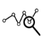

Setting up Adobe Target for experiential targeting for Walgreens
OPTIMIZATION = PERSONALIZATION + EXPERIMENTATION
KPI RATIONALIZATION & REPORTING
Know which content helps in engaging which customers
Understand how customers are being acquired & what is their navigation path
OPTIMIZATION TESTS
Understand which content is working best for customers
KPI Monitoring
Content Testing
NEXT BEST ACTION/NEXT BEST OFFER
Propensity Modeling
Customer Segmentation
Predictive Analysis for improving campaigns
Recommedation Engine
CUSTOMER BEHAVIOR ANALYSIS
Understand customer preferences & Recommend affinity-based targeting
Visitor Profiling
Visitor Intent Analysis
Conversion Funnel Analysis
Predictive Analysis
Affinity
Analysis
CAMPAIGN ROI ANALYSIS
Understand what is campaign effectiveness and which customers respond to a campaign
Test-Control Analysis
Regression Based Analysis
Campaign Effectiveness Analysis

Slide 92
Walgreens marketing campaigns – integration track project plan
APRIL |  | MAY |  |  |  | JUNE |  |  |  |  | JULY |  |  |  | AUG |  |  |  |  | SEP
20 | 27 | 4 | 11 | 18 | 25 | 1 | 8 | 15 | 22 | 29 | 6 | 13 | 20 | 27 | 3 | 10 | 17 | 24 | 31 | 7 | 14
Campaign
Audience Manager
Experience Manager
Analytics & Target
CI & API*
S4
Metadata Enablement
Schema Enablement
Folder Enablement
Integ. Enablement
S5
Schema Enablement
Folder Enablement
Integ. Enablement
S6
Schema Enablement
Folder Enablement
Integ. Enablement
S7
Schema Enablement
Integ. Enablement
S8
SIT Execution
Regression & Performance Testing
UAT Support
S3
Story Elaboration
Backlog Grooming
Metadata Enablement
Schema Enablement
S9
S10
Launch Planning
S11
Launch
Hypercare
S4
Story Elaboration
Backlog Grooming
Integ. Enablement
S5
Data Enablement
Integ. Enablement
S6
Data Enablement
Integ. Enablement
S7
Data Enablement
Integ. Enablement
S8
SIT Execution
Regression & Performance Testing
UAT Support
S9
S10
Launch Planning
S11
Launch
Hypercare
S4
Story Elaboration
Backlog Grooming
Component Dev
Email Template Dev
Exp. Fragment Config
S5
Workflow & Cloud Config for AT+AA
Assets Cleanup
S6
Assets Cleanup
S7
Content Sync & Activation
Assets Activation
S8
Upstream to CI/OMS System Flow
SIT Regression & Performance Testing
UAT Support
S9
S10
Launch Planning
Assets Publishing & Search
S11
Launch
Hypercare
S3
Story Elaboration
Backlog Grooming
Launch Config
AA/AAC Integration
S4
AAM/AT Integration
S5
Design Experiments
S6
Experience Targeting for Email & Web
S7
AA Dashboard Development in Workspace
S8
AEC SIT + UAT Support
AA–Dashboard Development
CI–Data Access to AEC
API–Test Data Ready
S11
Launch
Hypercare
S9
S10
Launch Planning
AEM – Assets Publishing
CI/API–UAT + Prod Environment Ready
S3
Story Elaboration
Backlog Grooming
Integration Spec.
S4
Test File (SFTP) / Stubbed API (P2P)
S5
Preparing Dynamic & Static Segments Attributes
S6
Create Behavior Based Segments
SIT Environment
S7
Build Predictive Intelligence
Use Case Test Data
S8
Data Access to Adobe Experience Cloud
UAT Environment Ready
S11
Launch
Hypercare
S9
S10
Launch Planning
Prod Environment Ready
*CI & API will be executed as part of the Harmony & WW tracks, however, we have accounted for dependencies during the MarTech implementation track.

Slide 93
Boots marketing campaigns – integration track project plan
APRIL |  | MAY |  |  |  | JUNE |  |  |  |  | JULY |  |  |  | AUG |  |  |  |  | SEP
20 | 27 | 4 | 11 | 18 | 25 | 1 | 8 | 15 | 22 | 29 | 6 | 13 | 20 | 27 | 3 | 10 | 17 | 24 | 31 | 7 | 14
Campaign
Audience Manager
Experience Manager
Analytics
CI & API*
S4
Metadata Enablement
Schema Enablement
Folder Enablement
Integ. Enablement
S5
Schema Enablement
Folder Enablement
Integ. Enablement
S6
Schema Enablement
Folder Enablement
Integ. Enablement
S7
Schema Enablement
Integ. Enablement
S8
SIT Execution
Regression & Performance Testing
UAT Support
S3
Story Elaboration
Backlog Grooming
Metadata Enablement
Schema Enablement
S9
S10
Launch Planning
S11
Launch
Hypercare
S4
Story Elaboration
Backlog Grooming
Integ. Enablement
S5
Data Enablement
Integ. Enablement
S6
Data Enablement
Integ. Enablement
S7
Data Enablement
Integ. Enablement
S8
SIT Execution
Regression & Performance Testing
UAT Support
S9
S10
Launch Planning
S11
Launch
Hypercare
S4
Story Elaboration
Backlog Grooming
Component Dev
Email Template Dev
Exp. Fragment Config
S5
Workflow & Cloud Config for AA
Assets Cleanup
S6
Content Sync & Activation
S7
Content Sync & Activation
S8
Upstream to CI/OMS System Flow
SIT Regression & Performance Testing
UAT Support
S9
S10
Launch Planning
Assets Publishing
S11
Launch
Hypercare
S3g
Story Elaboration
Backlog Grooming
Launch Config
S4
Launch Config
S5
Purchase Funnel Tagging
S6
Purchase Funnel Tagging
S7
Dashboard Development in Workspace
S8
AEC SIT + UAT Support
S11
Launch
Hypercare
S9
S10
Launch Planning
S3
Story Elaboration
Backlog Grooming
Integration Spec.
S4
Test File (SFTP) / Stubbed API (P2P)
S5
Preparing Dynamic & Static Segments Attributes
S6
Create Behavior Based Segments
SIT Environment
S7
Build Predictive Intelligence
Use Case Test Data
S8
Data Access to Adobe Experience Cloud
UAT Environment Ready
S11
Launch
Hypercare
S9
S10
Launch Planning
Prod Environment Ready
*CI & API will be executed as part of the Harmony & WW tracks, however, we have accounted for dependencies during the MarTech implementation track.

Slide 94

MarTech implementation: pod structure
 | Program pod | walgreens pod - US | Boots pod - UK
Product Manager
Multi-Solution Architect
Campaign Architect
CDP Lead
Functional Consultant
Analytics Lead
AEM Lead
AAM/ACM Lead
Integration Lead
Proxy PO
Scrum Master
Developers
QE
legend
ONSHORE
OFFSHORE

Slide 95
Engaging with Adobe to position the program for success
We are recommending an Adobe services partnership to enable design validation & oversight and enabling the right Adobe Experience Cloud stack for WBA.
SUGGESTED ROLES* | PROGRAM PHASE | PERSON WEEKS | TOTAL EFFORT PERSON WEEKS
AAM Consultant | Discovery and implementation | 10 | 40
Campaign Consultant | Discovery and implementation | 10
Adobe Dynamic Media Consultant | Discovery and implementation | 10
Adobe Analytics Business Consultant | Discovery and implementation | 10
*Not in our submitted pricing estimates

Slide 96
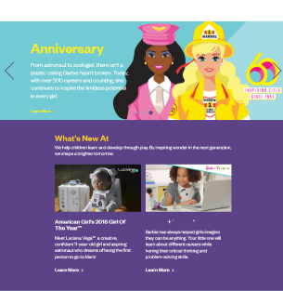
Transforming the CX of a multi-Brand, multi-national using Adobe
SUCCESS STORY
For a leading toy company
THE STORY
WE DELIVERED
STRATEGY
DESIGN
OMNI
CHANNEL
CONTENT AT SCALE
NEXT-GEN COMMERCE
The client's mission is to create innovative products and experiences that inspire, entertain and develop kids through play.
To achieve this the client sought to improve customer engagement and brand immersion at various touchpoints while maintaining speed-to-market through streamlined marketing operations and integrated, scalable technologies.
UX Rationalization: Experience journey enablement per each brand’s unique value proposition
Digital Marketing Enablement: Nimble architecture to enable the redefined digital experience through AMC solution
E-commerce Integration: Personalized and innovative experience based on evolving interests data of visitors
GDPR Compliance: Define policy and create data collection framework
PRODUCTS
LEVERAGED
360*
Simplified, customized marketing with cross-functional integration
Faster time-to-market with predictable operation cost
View of customer
Faster creative build & approvals – more time for quality
Improved content relevance and engagement
Semi-automated regulatory compliance

Slide 97
Creating an E2E CX and martech transformation using Adobe
SUCCESS STORY
For a leading American healthcare provider
SOLUTION APPROACH ON ADOBE CLOUD
CONSOLIDATE DIGITAL EXPERIENCES ACROSS ENTERPRISE | STREAMLINE OPERATIONS AND ADMINISTRATION | SUPPORT SCALABLE ADOPTION BY TENANTS | ESTABLISH EFFECTIVE DIGITAL GOVERNANCE
Consolidate and integrate various digital experience and marketing technologies adopted by tenants Improve quality of analytics insights by configuring Adobe Analytics to support cross-site journey reporting | Enable migration of disparate CMS installations to a single enterprise-grade federated AMS cloud platform Optimize release management via true blue-green capability | Create and run a digital delivery pipeline with built-in quality and automation Productize and evolve an service catalog with tenant enablers and self-service options | Provide governance and communities of practice to uplift digital execution throughout Enterprise Establish standards, best practices, and playbooks for tenants Voice of the Customer in governance will influence product and platform evolution

Slide 98
Leading American Health Care Provider - platform operational view
SUCCESS STORY
CUSTOMER ENGAGEMENT PLATFORM
PLATFORM INFRASTRUCTURE
PLATFORM FOUNDATIONAL LIBRARIES / ASSETS
PLATFORM DEVELOPMENT TEAM
PLATFORM SUPPORT TEAM
PLATFORM EVANGELISTS
TENANT N
TENANT 1
TENANT 2
Development Team
WEBSITES
WEBSITES
Shared Services Roll-out Team
WEBSITES
DATA INTEGRATIONS
DATA INTEGRATIONS
DATA INTEGRATIONS
A/B / ONLINE TESTS
A/B / ONLINE TESTS
Shared Services Marketing Operation Team
A/B / ONLINE TESTS
CAMPAIGNS
CAMPAIGNS
CAMPAIGNS

Slide 99
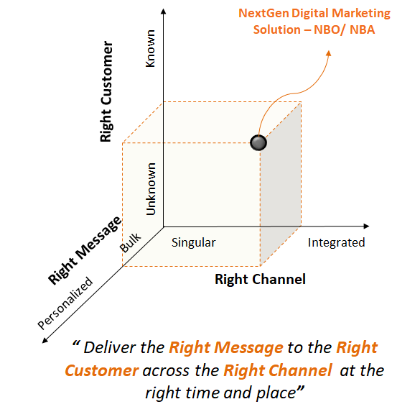
Enabling next best action & omnichannel orchestration using Adobe campaign
SUCCESS STORY
For a leading German auto manufacturer
OBJECTIVES
Develop superior capabilities, methods and tools to enable best-in-class automotive customer lifecycle analytics
Enable, build and run a set of pilot projects to prove the value to BMW stakeholders
Provide an innovation and operation platform to provide automated decision making and execute next best action at each customer touch point
Provide analytical services to NSCs, dealers and corporate functions globally
CUSTOMER DIALOGUE CHARACTERISTCS

Slide 100
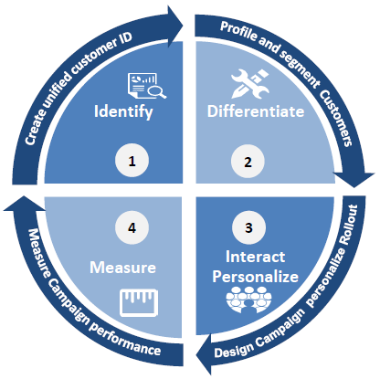
Breaking the next best action & omnichannel orchestration problem into a logical solution
SUCCESS STORY
Define and implement a next gen framework and use the “dynamic customer context” to orchestrate interactions through all touchpoints to drive innovation
HOW TO ACHIEVE IT
SOLUTION IMPERATIVES
MOST RELEVENT ACTION
AT THE RIGHT TIME
TO DRIVE CUSTOMER TRUST
OPTIMIZE CHANNEL PERFORMANCE
ACCELERATED ROLL OUT
INCREMENTAL DELIVERY
PROMOTE REUSE
DESIGN FOR FUTURE
NBO / NBA SOLUTION FRAMEWORK

Slide 101
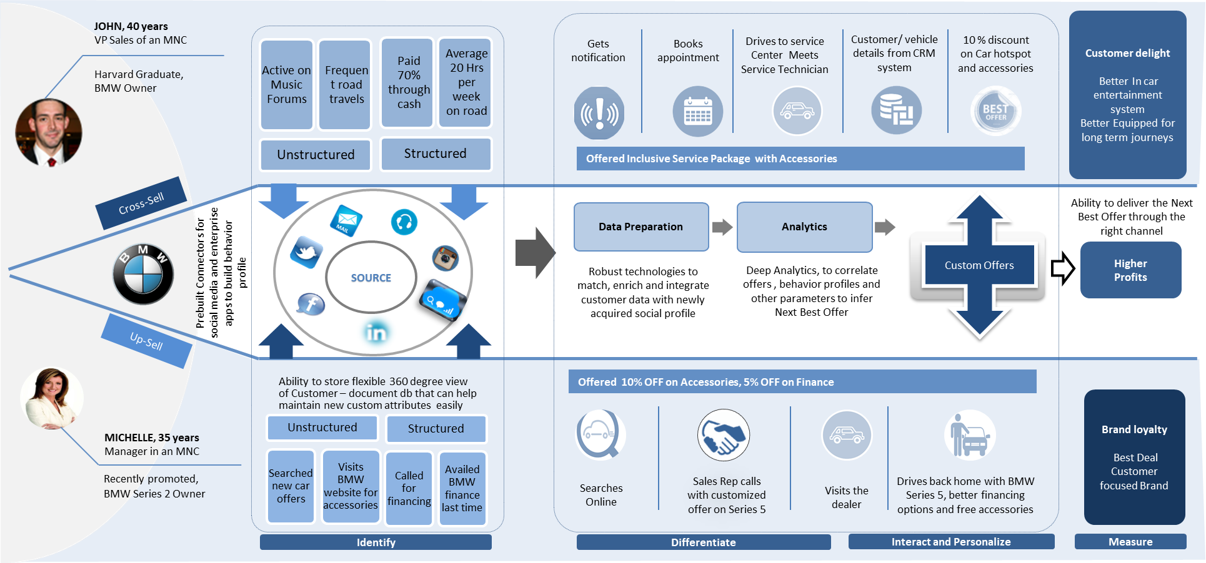
Understanding the customer and day-in-the-life helped shape our solution perspective
SUCCESS STORY

Slide 102
Key entry & exit dependencies for MarTech implementation track
Below are some of the Key DEPENDENCIES that drive the start and conclusion of the program.
Upstream Activities / Inbound Integrations
Downstream Activities / Outbound Integrations
DATA
AND CDP
CREATIVES / AGENCY SERVICES
DATA
AND CDP
All Data Stitching / Aggregation/ Modelling Work needed for the Marketing Usecases will be enabled by the CI Team external to the marketing track
All API Services (for Data Onboarding and Consumption in Adobe) & Batch data files will be developed by CI Team and will made available for marketing track
All wireframes / Designs / UX needed for development of Newsletter Templates and Experience Offers will be made available to the marketing track.
All Print Fulfillment Data set will be generated by Marketing Track and will be delivered via the Azure Blob store and integrations built as part of the CI Platform.
All API services need for ingesting Campaign metrics and Web/ Mobile Analytics will be created by the CI Team & invoked by Marketing Track
NOT SCOPED IN MARTECH TRACK

Slide 103
Engagement scope and assumptions
IN SCOPE
AEM
ADOBE CAMPAIGN
AEM Assets Upgrade (Walgreens) & AEM Assets rollout (Boots)
Email Template, Experience Fragments (for Target) , Workflow, Content Creation
Integrations for ingestion points
Integration of AEM (Author, Publish ) with Analytics , Adobe Campaign, Target System, Audience Manager
Dispatcher Configuration, User Group and ACL Setup
Deployment and Testing and Warranty Support
Support for Security and Performance (need confirmation) Testing
Platform setup
Application Setup (Nav hierarchy, access management, user profile setup)
Following configurations are scoped in
20 custom schema creation
12 data loading workflow via files from Azure Blob storage
10 data export workflow
Transactional email, Direct Mail, Mobile Push Enablement/Mobile APP enablement/Web channel enablement
Integration with AA, AEM, AT (Walgreens only), AAM & Experience Cloud Event Pipeline
SSO Authentication using Adobe Identity Management Services
Build common personalization blocks like unsub link, mirror page ect.
Knowledge transition to Campaign execution team
ADOBE ANALYTICS (Boots only)
Identify & Configure Additional Variables for leverage in Adobe Campaign
Configure Analytics for Target (A4T) Integration
Integration with AAM
Marketing Pixels, and Conversion tagging using Adobe Launch
Adobe Target Enablement using Adobe Launch
Marketing Channels Configuration in Adobe Analytics
Campaign Tracking Template for capturing user metadata in Adobe Analytics
Reports & Dashboards in Adobe Analysis Workspace
AAM
Platform setup
Setting up of user access configuration in AAM
Configuration and verification of AWS S3(or FTP) Access for AAM
Setting up of folder structure in AAM
Setting up of profile merge rules in AAM
SSO Authentication using Adobe Identity Management Services
Following Integrations are scoped in
AAM & AC integration
AAM & AT integration
AAM & DSP Integrations
AAM & 3rd Party data integration
CI
Built Relationship Mapping, & Create Customer Segments for Marketing Use Cases
Run ML models using Azure ML service for 2 Use Cases
Data Integration between CI, & Adobe cloud platform, and response to WBA data stores
CI to support 4 Use Cases for Walgreens, & 3 Use Cases for Boots
All use cases would be reviewed to understand the CI leverage during Marketing Use Case Understanding phase

Slide 104
Engagement scope and assumptions
OUT OF SCOPE
PROGRAM
AAM / ACM
Any area not explicitly mentioned under in scope
Any customization of base product features
UAT Test Cases preparation & UAT Execution
Infrastructure related support services
Support for Integrated Applications
Network/ Security configuration
Adobe platform(hardware/ OS) monitoring
Environment backup, restore, failover and Disaster Recovery
Deployment and maintenance of 3rd party
Software, Hardware & Server procurement and maintenance
Release Management of non-minor enhancements
Data Cleansing and Quality
Any data source Integration with Adobe Campaign
Any Integration other than what is included into the scope
Development of any custom reports
Any other functionality not supported OOTB by Adobe Campaign
Building of Any Email or Web apps using HTML directly in Campaign
Upgrade and environment maintenance
Language support other than English
Any Additional/ New Campaign Build/ Execution other than the campaigns considered in scope
Configuration of Data encryption (rest and transit)
Configuration of Interaction & Offer Management, Coupon module on Campaign platform
Any customization or work around to achieve business requirement that is not feasible using adobe provided connector
Data migration from legacy system/ application or from 3rd party system
Building or amendment of Mobile App
Building of any API
Configuration of connectors other than those needed to integrate Adobe products in scope and Azure Blob storage
ADOBE ANALYTICS
Identify & Configure Additional Variables for leverage in Adobe Campaign
Configure Analytics for Target (A4T) Integration
Integration with AAM
Marketing Pixels, and Conversion tagging using Adobe Launch
Adobe Target Enablement using Adobe Launch
Marketing Channels Configuration in Adobe Analytics
Campaign Tracking Template for capturing user metadata in Adobe Analytics
Reports, & Dashboards in Adobe Analysis Workspace
Mobile Apps , Emails. Paid Media
Training Documentation, & Training Sessions
Server side or Client side integration of Adobe Audience Manager
Optimization, & Personalization using Adobe Target
Ongoing Data Analysis, & Reporting. And Production Support
Predictive Analytics

Slide 105
Engagement scope and assumptions
OUT OF SCOPE
AEM
CI
Any Implementation / Updates to websites on AEM Sites or any other technology.
Development of Landing pages in AEM Sites (both Walgreens and Boots)
Any new DAM workflow or metadata / taxonomy as part of AEM Upgrades.
Asset / content Migration is not in scope of the project for AEM Assets.
Validation Testing, Implementation of Asset Share Commons and Setup of Performance Monitoring tools is considered out of scope
Support any other Use Case apart from the ones in scope
Using any other TechStack apart from CI Predictive Intelligence, & Azure ML service for building the ML out puts
Any other Data apart from ones in scope
Real time Data Access

Slide 106
Engagement scope and assumptions
ASSUMPTIONS
ADOBE CAMPAIGN
ADOBE ANALYTICS
Templates and Creatives will be built in AEM and pulled in Campaign delivery
AEM will be used as DAM, all the assets will be uploaded and their respective URL’s will be used in Campaign
Email and Push templates for all campaigns will be made available for integration before start of campaign development
WBA will provide the details of the fields needed by Direct mail channel
Email Delivery Server configuration, Domain delegation and proxy server configuration will be done by Adobe support team with assistance of Cognizant and WBA network team
Email and SMS Service Provider to be used for campaigns will be identified by WBA
All the integrations will use file from Azure Blob Storage or Adobe Provided Connectors
A campaign workflow will have maximum 2 deliveries per channel to handle AB testing
Only the functionalities supported out of the box by Adobe Campaign will be Implemented
UAT design and execution will be owned by WBA. During UAT the scope for Cognizant team will be limited to fixing of Configuration related defects
Launch Migration is underway and would be completed before the commencement of this project
Adobe SSO integration, & Migration of existing users to Federated Identity would be enabled by Adobe
Adobe Target, & Adobe Analytics Deployment via Adobe Launch on Walgreens Website alone
Google Analytics would be the primary Web Analytics Solution
Adobe SSO integration, & Migration of existing users to Federated Identity would be enabled by Adobe
Adobe Analytics deployment via Adobe Launch would be implemented for the 3 Use Cases in scope. And, this would be for Website (1) only
AAM / AEM
No Asset / content Migration are planned as part of this project.
The Metadata / Taxonomy and Asset Workflows are expected to be already defined and available from the program definition phase.
The designs for the campaign newsletter and Target Offers are available and signed off by the start of the project.
Information architecture definition - Metadata & taxonomy design will be handed over as a part of Discovery to be considered for upgrade consideration
Existing architectural design of the solution across US & EU DAM and integration of DAM processes with broader organizational solutions
It is assumed that the environment will be setup by Adobe on AMS cloud.
CI
WBA would have licenses to Azure ML services to run Analytics Models
Adobe Cloud Platform to subscribe to CSV, & JSON files.
Data Access would be batch mode

Slide 107
Quality Engineering & Assurance

Slide 108
Quality engineering & assurance solution summary
HOLISTIC QA SOLUTION TO ENSURE SUCCESS
PROGRAM TRACKS
COGNIZANT SOLUTION
OUTCOMES
HARMONY
Omnichannel pharmacy order lifecycle throughout pharmacy process
Reusability
400+ reusable scenarios from Pharmacy Order life cycle management & 300+ reusable test scenario from Digital Marketing and Beauty based engagements
CARTS – Pre- Build reusable test scenario repository - 20% Test Scripting Effort Reduction
EasyRepro -Reusable Components for Test Automation in CIQD, Advensure,CIEEM
Digital Marketing Business Process Assurance Framework
End to End Business Process Assurance
Quality Gates: Guardian of quality.
Robust integration Performance Testing
CIEEM: Synthetic Monitoring Tool for Cloud
CXOptimize: End User Performance Monitoring.
< 5%
Defect leakage to and Production
WONDER WOMAN
Beauty consultation in-store service for Boots with aim to enhance customer experience
70%
Automation Coverage
Automation
“Automate First” Test approach
Customized API test automation framework using Java + cucumber + Rest Assured
CORE TEST AUTOMATION for Marketing campaign
NEXT GEN AUTOMATION for CI
Leverage FASTEST platform for surge on demand testing
Right Talent
Leader in Gartner Magic Quadrant for Application Testing Services, for 5 years in a row
QA enabled SDET for POD based quality assurance
Day 1 ready team for jump start testing
Leveraging 3 Walgreen & Boots QA experienced associates for this program
WALGREENS & BOOTS MARKETING
Marketing campaign to build relationship with new local customers & increase engagement with un-engaged customers
20%
Manual Testing Effort reduction
Notes:
Digital Supply Chain Transformation
Business Process re-engineering and streamlining through best available COTS policy
Oracle EBS and Kofax support policy

Slide 109

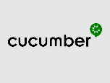






Quality engineering & assurance solution scope
HARMONY
WONDER WOMAN
WALGREENS & BOOTS MARKETING
SIT & E2E Testing: Cross channels, POS, Legacy systems, Functional SIT and E2E Test Execution
Automation Testing: 7 API’s
SIT & E2E Testing: Data Validations, Data Mapping Rules, Outbound and Inbound
Automation Testing: 5 API’s
SIT & E2E Testing: 4 Email Campaigns (Walgreens); 3 Email campaigns (Boots)
Automation Testing: Campaign Management and Automated Email Validations
Accessibility Testing: 7 Templates on WCAG 2.1 Level AA guidelines
Performance Testing: Load & Stress Testing of Middleware (15 API’s); Monitoring System Performance | Security Testing: 12 API’s & Web Services; Infra Penetration Testing for IP servers | UAT: Test script writing & testing support OAT: Testing Support
TOOLS & ACCELERATORS
CARTS
EasyRepro
ADVensure
+
+
CIEEM
CIQD
CXOptimize
fastest
Test Automation
Test Management
Defect Management
Performance Testing
Security Testing
Notes:
Digital Supply Chain Transformation
Business Process re-engineering and streamlining through best available COTS policy
Oracle EBS and Kofax support policy

Slide 110
Quality engineering & assurance accelerators
COGNIZANT PROPRIETARY TOOLS THAT IMPROVE TEST EFFICIENCY AND REDUCE COST OF QUALITY
Reusable Test Case Repository (CARTS)
Cache Of Reusable Test Scenarios to Optimize Test Design Effort.
Reusable Test Scenarios across various Pharmacy & Retail domains
Test Design – 4 Wall Testing, System Integration Testing, Regression Testing
Test Design & Business Process Automation (CIQD)
Cognizant Intelligent Quality Designer assists in faster business process flows with automated test scenario generation
Helps in automating test design process, integrating with business process flows; Helps validate against requirements
Test Design – 4 Wall Testing, Regression Testing
Data Validation Automation Framework - ADVensure
Automation framework developed on Java platform for automatic data validation – Reconciliation, Accuracy, Completeness etc.
Detailed reporting comparison and outputs are repeatable
~20% Test Design Effort Savings
15-20% Test Design Effort Savings
~20% Test Execution Effort Reduction
Reusable Components for Test Automation - EasyRepro
Custom libraries, plug in and modules built for EasyRepro – Microsoft’s open source Automation framework
Built across Reporting (Custom Library), Test Data (Custom Plug-in)
Cognizant fastest
Cloud-based, on-demand software testing platform that helps in digitized test processes with predictable outcomes.
Swiftly scale testing needs for short durations and reduce total cost of ownership.
Cognizant Intelligent End-User Experience Monitor (CIEEM)
Synthetic monitoring solution for Cloud infrastructure that proactively monitors webpage performance
Proactively catch performance issues in cloud production setup not waiting for end user to report
Synthetic Monitoring, Real-Time UX Monitoring
15-30% Effort Savings in Automation Script Design
0% Mobile Device Holding Cost
Monitors Application Availability & UX 24X7
Notes:
Digital Supply Chain Transformation
Business Process re-engineering and streamlining through best available COTS policy
Oracle EBS and Kofax support policy

Slide 111
Quality engineering & assurance: assumptions & dependencies
ASSUMPTIONS
XRAY for Test case management, JIRA for defect management and status reporting.
API Test automation and Marketing Campaign test automation using Open source frameworks and tools and will be finalized during the due diligence phase of the engagement.
Accessibility testing of the templates in 3 platforms (Desktop, Mobile & Tablet) & 2 browsers (Chrome & Safari) in each platform is considered for this estimation. Chrome browser in all 3 platforms are considered as primary browser (100% effort) & Safari is considered as secondary browser (80% effort)
For Accessibility testing , 120 Defects(20 defects per browser per platform) is considered for defect only retest. Increase in defect could would need additional effort and 40 Defects is considered for remediation support. Increase in defect could would need additional effort
Accessibility testing will be restricted to English language screens/content
Security testing will be carried out on pre-Production, and not on Production systems; a functionally-stable instance of the application will be deployed in this dedicated environment during the security testing phase.
Security testing team will be provided with connectivity for accessing the APIs and Infra components which are subjected to assessment. Cognizant will provide respective commercial tools for this engagement and this will be billed against client. Open source tools such as BurpSuite, ZAP, SoapUI will be used for additional coverage as well as for false positive analysis. The application will be benchmarked against OWASP Top 10 standards.
Performance testing will be done for critical services. Cognizant expects 10-12 services are critical for each of Harmony and Wonder Woman and 5-6 services are critical for Walgreens and Boots Marketing Campaign.
Performance environment should be available and should be at least 50% of Production
Data volumes are comparable to Production sizing in the performance environment
NFRs will be determined for each of the services identified and required support needed from WBA teams
VMs/environment setup of Performance testing tools will be provided by WBA
Availability of APM tools and Monitoring tools will be available and can be leveraged during Performance testing
Performance team will be participating in all the architectural discussions (n+1 release) and will provide architectural recommendations for frameworks and Patterns around Performance and Resilience
Partner Performance environment will be utilized for E2E testing if available in DTS zone, else Service virtualization will be leveraged
Virtual services used by engineering team will be re-used for early performance testing of the platform
Work Load Model will be determined during the initial sprints

Slide 112
Quality engineering & assurance: assumptions & dependencies
DEPENDENCIES
Client/Project team shall provide Performance test infrastructure ( Required Controller & Load Generator machines)
Client/Project team shall install and configure required testing tools
Client/Project team shall provide performance test environment similar to that of production for testing purpose
Necessary access to load testing environment for test scripting, data creation, test execution and monitoring will be provided to PT team
Availability of single point-of-contact / coordinator from application team for arranging discussions with application SME, facilitating required system access and providing clarifications.
Support from system administrators & DBAs for server monitoring / analysis.
The resources will be on - boarded /ramped down by Accessibility testing team with an advance notice of 2-3 weeks for performing the accessibility evaluation
Mobile and MAC Devices should be provided by project team
Application is accessible over internet (or) connectivity is available from ODC for non-internet application
Test data should be provided by the project team to access the applications
Access to defect management tool should be provided (if applicable) by project team

Slide 113
Campaign Execution Partner

Slide 114
OVERCOMING KEY CHALLENGES
You need marketing excellence, orchestrated by local teams, that know how to get the best out of AEC, while operating at-speed and at-scale
We have deep experience & expertise in healthcare marketing – we understand the regulations in the space and what patient want and need to improve outcomes
We’ve aligned dedicated local teams to deliver for Walgreens & Boots independently
With one of the largest AI teams in the world, we’re on the forefront of enabling intelligent personalized marketing optimization, powered by our at-scale global content services team

Slide 115



Our Understanding
While Cognizant can and has worked across both a coupled and de-coupled model for Campaign Execution, our experience is that sole-source delivery enables additional value via:
A single partner for WBA to coordinate with (streamlining communications with WBA and internally via execution
Our Integration and tech teams understand deeply the CSFs for execution success and our campaign delivery teams have Adobe and Data resources that “speak the language” minimizing questions/delays in production
Global understanding of the intersection of healthcare and retail customer behavior and preference
As part of the overall Customer Experience Transformation driven by Walgreens-Boots, a Campaign Execution partner for Walgreens US and Boots UK is needed to drive the strategic evolution of customer engagement and drive optimized results for how customers engage with Walgreens US across channels

Slide 116



Our Solution will Drive Value for WBA
Speed To Market | Global Team | Cost
Our pragmatic and output oriented approach guarantees to implement and run the defined campaigns in the given timeframe | Our highly skilled and flexible global teams will apply our unbeaten expertise in building and running complex MarTech solutions | Our mix of on-site and off-shore resources provides the most cost-effective solution, maintaining our high standards of pod based delivery

Slide 117


Cx is at the Core of Our Approach
Customer Experience is not just the responsibility of our strategy and creative teams. Every discipline engaged with project Fiore has a CX perspective and is accountable for maximizing a positive user brand experience - from our data analysts reviewing campaign results and creating optimization recommendations through to our HTML developers ensuring that content is viewable on every device.
We have all the pieces to deliver
Data is Our Best Friend
Analyzing and assessing data directs our teams strategic, creative and channel choices. We combine qualitative and quantitative data to create a hyper-personalized brand experience that is continually monitored to ensure it provides the optimized consumer experience and delivers value to your brand and business.
Healthcare and Retail are Our Passion
We don’t just have a deep legacy with the retail and healthcare category it is our passion. We understand the distinctive needs of retail and regulations associated with the pharmacy business.

Slide 118
Establishing the Global Operation
Setting up the common, global ways of working, team, and campaign operation to enable efficient localization for Walgreens & Boots

Slide 119
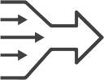

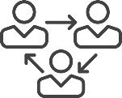


ELEMENTS of Our Global Operational Approach
Simplified Project Transitions Smooth and effortless transition from technical integration to platform campaign execution | Streamlined Communications Internal and client communications channels are uncomplicated and straightforward with one individual project partner | Shared Resources Our global model shares resources to ensure project efficiency, campaign knowledge and execution proficiency | Single Model A single global model enables all client partners to have a complete understanding of our end to end campaign process. Knowledge and resources can easily be allocated to any location as demand is identified | Regional Flexibility Our operational model understands regions have specific needs and adapts to regional requirements as appropriate.

Slide 120

Cognizant Campaign Management Operating Model
Strategy and Governance
Optimally structured and modular
SME-led work streams
On-demand expertise for specialty projects
Process-driven and repeatable
Data driven journey automation where possible
Platform and Data Readiness Project Planning, Delivery Management, Integration and Handover | Creative Production | Campaign Management Demand Planning, Customer Success Management, Reporting and Optimization
Platform Stand-up and Configuration |  | Campaign Planning and Design
Modular Integration |  | Campaign Set-up and Execution
Security and Access |  | UX Development
Data Design And Data Integration |  | Data Analytics and Reporting
WBA business + agency
Integration Partner
Operations support
Key Enablers | Shared Functions
Domain expertise, AEC certified resource pool | UX Design
Pre-defined, tested and reusable templates, component library & integration codebase | Solution Architecture
 | Data Modelling and Connectors
Follow the sun support model | Asset Integration and Management

Slide 121




Our Marketing Campaign Delivery Team
THE SQUAD
One Team
All use cases delivered from one team with specific roles dedicated to Boots and Walgreens respectively
Dedicated execution campaign consultants for each use case
Cognizant program directors (dedicated) to drive coordination between Walgreens and Boots
Regionally dedicated teams for synergies and shared learnings
Shared marketing ops services to scale up and down
Close collaboration within team to ensure rapid change management
Coordination with Walgreens and Boots programs for shared learnings and operations management
Cognizant Campaign Lead (US)
Cognizant Campaign Lead (UK)
Lead Campaign Consultant | Lead Creative Supervisor | Lead Copy Writer | Lead UI/UX Consultant | Lead Data Consultant | Lead Marketing Ops
Campaign Services Team
 | Brief and Plan | Readiness | Execution | Report and optimization | Hypercare optional
Creative Production Media Designer, Writer, Print Mgr
Martech Consultant
Martech Engineer
Frontend Developer
Test & QA
Data Science Engineer
Marketing Ops
STUDIO(s)
Onshore
Offshore
Nearshore

Slide 122




We understand the technology to deliver all of WBA’s use cases
Data sources
Data Foundation
Content Services
Touchpoints
Inbound Ad Visitor
Audiences & Segments
Online
Anonymous Web Visitor
Segments & Attributes
Success Metrics
Analytics
Optimization, Testing Recommendation
Authenticated Web Visitor
Click Traffic
Segments
Trigger Events
Rules and Segmented Content
Pull
Unintegrated contact data
CMS Content Services
Templates & Components
Website
Data:
Ingestion,
Structure,
Governance, Security
Modeling
CRM / ERP
Asset Management
Offline
Push
DWH/Enterprise Data Stream
Direct Mail
eMail Templates
PIM
Email
DWH / Enterprise Data Stream
Catalogue / PIM
Batch Import / Export
Message Delivery
Email Sent/ Bounce/Open/ Click
Marketing Automation
Mobile Apps
ONline
SMS / Mobile Notification
Digital Media
PRODUCTS
LEVERAGED

Slide 123
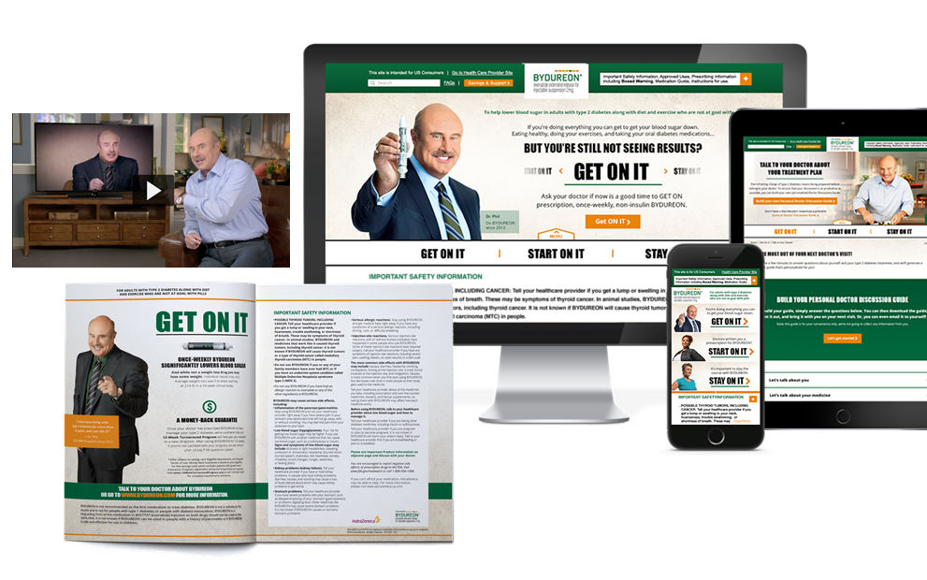
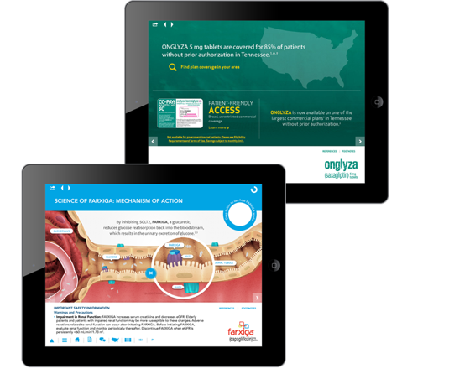

Delivering content-at-scale for a global pharma on AEM
SUCCESS STORY
The Story
Client had significant pipeline pressures and was seeking cost savings to reinvest
Lack of consistency in creating content across markets while leveraging tools, and publishing technologies that had been put in place
Agencies were enabling inefficiencies and creating inconsistencies in content messaging across digital channels
We Delivered
Establish a pilot to design and co-create an operating model to create and publish content across the EU market assigning success measures to prove the value
Established a rigorous onboarding programs for agencies and brands to consume the services including catalogue based pricing and clear hand-offs
Delivered a multi-year business case and roadmap to achieve financial and operational savings
50%
30%
PRODUCTS LEVERAGED
cost savings through faster TAT and production
faster time to market for websites and delivery channels
Adobe Experience Manager

Slide 124
Unified Campaign Management
Enabling the global process to drive efficient campaign execution for Walgreens & Boots.

Slide 125
WBA marketing campaign execution scope of work
Understanding the campaign brief provided by WBA Review/evolve the campaign workflow (if deviations to generic workflows) Defining selection criteria for the target group (CDP) Define rules governing exclusions (contact density & GDPR) Defining success criteria Campaign creative asset receipt and direction | Checking all needed tool and data integrations are available for the chosen use case and campaign type Running tests for target group selection Ensuring availability of additional data loads Managing escalations to Integration Partner (in case of deviations to defined solution integration) Frontend coding for defined email and landing page templates Tagging strategy and taxonomy | Progress content from WBA/AOR assets and direction Source images from DAM/other and create e copy Layout assets by channel (aligned to campaign strategy) WBA review cycles Final production-ready file creation Include print production and mail time for Direct Mail | Building/extending Campaign workflows Building HTML email templates Running the recipient / target group selection Sending test email to defined seed groups Aligning with email deliverability team (IP warming for new IP addresses, sender score) Running the delivery | Continuous monitoring of campaign delivery Escalating in case of deliverability issues Preparing campaign success reporting Managing data response to defined source systems Providing recommendations for optimization
Campaign Brief and Plan
Platform and data readiness
Develop Creative Assets
Campaign Execution
Reporting, Analysis and optimization

Slide 126
Campaign Strategy
Campaign Brief and Plan
Platform and data readiness
Develop Creative Assets
Campaign Execution
Reporting, Analysis and optimization
Use case immersion
High level strategic vision journey mapping
Offer, content and personalization finalization
Offer, content and personalization planning
Campaign journey maps including campaign tests
Testing hypothesis and planning
Hand off and coordination with creative and execution team
Determine campaign kpi’s
• | • | • | • | • | • | • | • | • | • | •
Use case campaign brief
Client feedback and approval
Client feedback and approval

Slide 127
Platform and Data Readiness
Campaign Brief and Plan
Platform and data readiness
Develop Creative Assets
Campaign Execution
Reporting, Analysis and optimization
Validate platform readiness
Confirm data structures
Confirm integration points
Perform testing
Identify and segment high value audiences based on customer behavior, geography, demographics etc.
• | • | • | • | •
Provide training and documentation
Make Adobe marketing platforms available
Perform data aggregation and audience data ingestion
1st party – offline, online, CRM etc.
2nd party – partner data
3rd party – data agency integrations
Cognizant Interactive Tasks | WBA Tasks
 | Perform data aggregation and audience data ingestion 1st party – offline, online, CRM etc. 2nd party – partner data 3rd party – data agency integrations
 | Make Adobe marketing platforms available
 | Provide training and documentation
Validate platform readiness Confirm data structures Confirm integration points Perform testing
Identify and segment high value audiences based on customer behavior, geography, demographics etc.

Slide 128

How We Progress Digital Campaigns
Campaign Brief and Plan
Platform and data readiness
Develop Creative Assets
Campaign Execution
Reporting, Analysis and optimization
Review creative direction
Review media plan to ID ad units
Source visuals (from WBA DAM) / find new imagery for each asset / channel
Our Creative teams understand the standards and requirements for developing, loading and delivery optimized content within the Adobe Cloud – eliminating rework and streamlining transition from Creation to Launch
Create designs and copy for each asset/channel
Content updates
Create prod-ready files for loading into campaign
Deliver creative package to deployment team
• | • | • | • | • | • | • | • | • | • | •
Campaign brief delivery
Deliver creative concept/direction
​ WBA creative review
WBA final asset sign off
/ AOR
Notes:
MarOps – missing from your org
Tangible Business Benefits:
17 hour work day – faster asset development
Scalable with volume – additional cost savings
Centralized talent – pre-identified talent pool
Centralized knowledge – shorter time to onboard new talent
Standardized templates – fewer development cycles
Standardized KPIs – One set of metrics for optimization
Through these benefits, the MCM Production HUB will transform the business by reducing the cost of development across MCM channels, while also shortening the time it takes to deliver MCM channel solutions to market.

Slide 129

Campaign Development and Deployment
Campaign Brief and Plan
Platform and data readiness
Develop Creative Assets
Campaign Execution
Reporting, Analysis and optimization
Develop HTML for emails, landing pages and banners
Load the templates into AEM and Adobe Campaign
Create segmentation logic, user journeys and exclusion rules
Editorial review and proof correction
Create campaigns and validate the artifacts and logics associated with the campaign
Send out edited versions for approval
Campaign launch
Quality Check
• | • | • | • | • | • | • | • | •
Approve campaign

Slide 130
Campaign Reporting and Optimization
Campaign Brief and Plan
Platform and data readiness
Develop Creative Assets
Campaign Execution
Reporting, Analysis and optimization
Via a campaign performance dashboard analyze campaign performance against metrics and KPI’s
Provide optimization recommendations and approvals to the creative/execution team for integration into the current campaign
Develop additional reports per the Ad-hoc needs of the client
Report campaign performance (Weekly)
Provide a campaign results final report as a resource for future campaign planning
Determine and report campaign optimization opportunities and recommendations
Continue reporting and optimization cycle throughout the campaign lifecycle
• | • | • | • | • | • | • | • | • | •
Client feedback and optimization approvals
Client ad-hoc reporting requests
Ongoing client feedback and optimization approvals

Slide 131




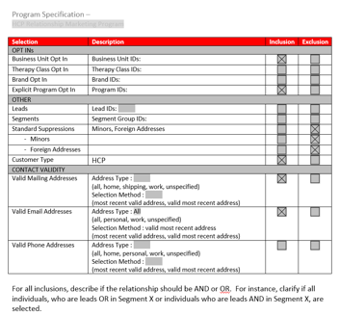
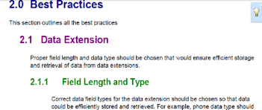
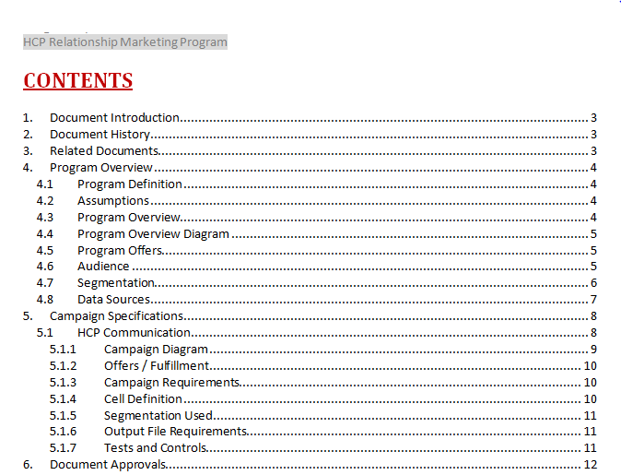
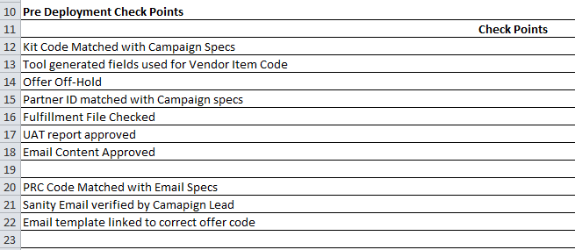
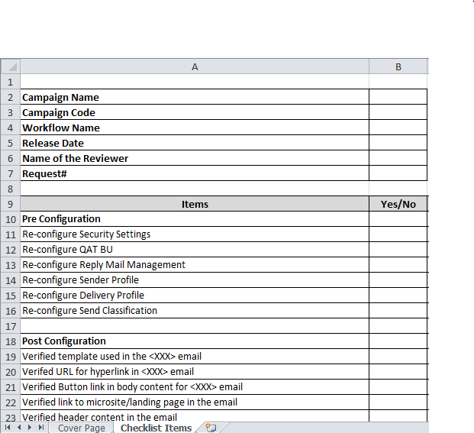
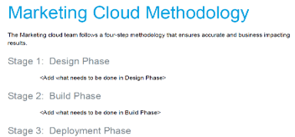
Enabled by Accelerators and Best Practices at Each Step
Campaign Delivery – Accelerators
Plan | Design | configure | Execute | Evaluate
Campaign Briefs | Campaign Run Book | Platform Best Practices and Configuration List | Pre-Deployment Checklist | Out of the Box / Custom Platform Report and Campaign Analytics
A complete overview of the campaign, providing a holistic view of the specifications to all stakeholders | Elaboration of campaign requirements. To help define the functional and technical scope of execution and key activities involved. Can be used by marketers for ready reference | Best practices to ensure that the platform is utilized effectively for optimal configuration of campaigns. | Checklist to ensure all the necessary quality checks, design triggers and passed though through audit check before campaign launch. | Campaign Management Platform out of the box reports can be used directly from the tool to measure campaign performance and effectiveness. Discover functionality that could be used to create custom reports.

Slide 132
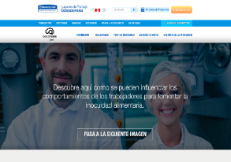


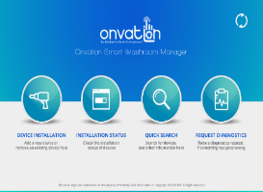



Global content services for a personal care brand’s marketing operations
SUCCESS STORY
The Story
Client was looking to consolidate and deliver their campaigns and content more efficiently
Needed a partner to globally support roll outs and provide publishing and content services first piloting in NA and extending globally
We Delivered
Cognizant partnered with the client to consolidate all their global campaign initiatives and activities
Delivered digital factory content production services
Created repository for assets to implement reusability, faster utilization of assets, low cost development and enabling Branding consistencies across multiple geographies
Implemented Multi-site approach and templatization for brand websites
The campaign consolidation program has covered close 30+brands, 123+projects, over 25 languages
30%
20%
25
PRODUCTS LEVERAGED
Adobe Products
Adobe Marketing Cloud
Time to Market
YOY Improvement in Cost Savings
Languages
PRODUCTS
LEVERAGED

Slide 133
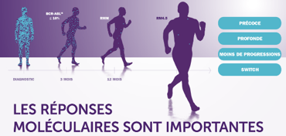
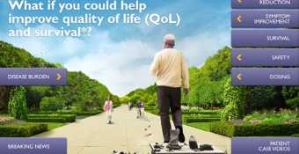




Multichannel digital production partner on SFMC & Veeva enabled via automation
SUCCESS STORY
The Story
Build and deliver CLM presentations and Field Marketing emails on Veeva and marketing campaign emails on SFMC platforms
Robust production model with competitive pricing driven by volume was required
Accommodate varied demands across the globe
Needed innovative solutions to meet growing market demands
We Delivered
Designed and set up a flex-services unit to cater to varied volumes of demand and ad-hoc requests
Delivered Veeva presentations with Co-Browse capabilities and Field marketing Emails through the factory model
Developed catalogue based pricing to ensure transparency and cost effectiveness
Project managed through dedicated service liaisons at client site to interact with customer marketing teams and business team to conceptualize, provide solution, and enable development
Delivered productivity discounts to client month to month as a result of efficiencies realized through our automated tools.
20,000+ Assets delivered | 600+ Marketing presentations / approved emails delivered | 30+ Countries
20+ Brands |  | 10+ Languages
PRODUCTS LEVERAGED
Adobe Products
Adobe Experience Manager
20% Faster time to market
20% Reusability
20% cost saving vs traditional AOR

Slide 134
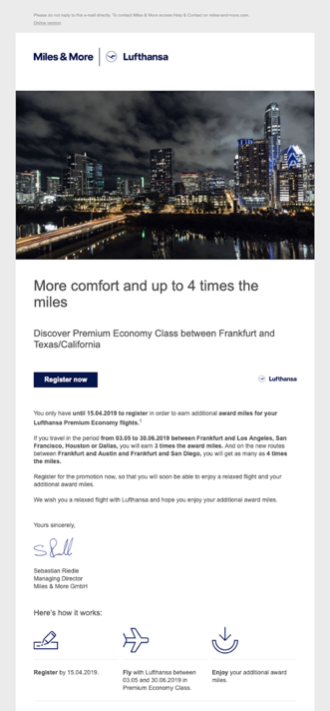
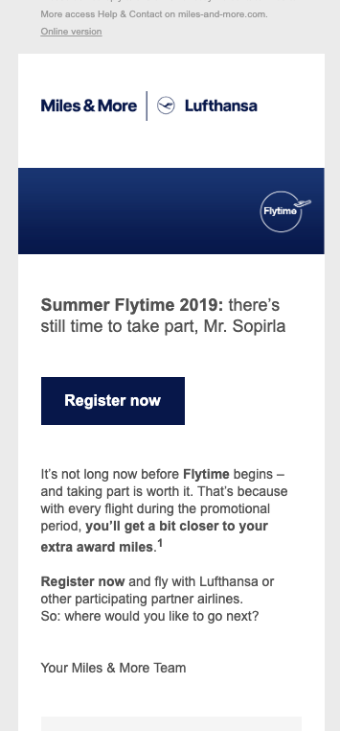

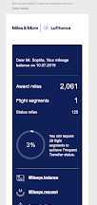



Driving personalization for a leading European airline
SUCCESS STORY
Approach
Implementation of Adobe Campaign and AEM which we completed using a continuous onsite team supported by nearshore delivery.
On-site training to support reorganization and the introduction of new workflows. It was vital to manage the human element of this change too.
The marketing team can now handle their own content creation and manage their email communications autonomously.
The time-to-market of an email campaign has been reduced from around 2-3 weeks to 1-2 days, saving time, resources and money.
Challenge
The implementation, and migration to, a new email management system, which would drive more personalized email campaigns and standardize customer communications was requested. The volume of email communications presented a principal challenge: a system was needed that supported daily email correspondence in 10 different languages.
Inhouse email campaign solution, no more dependence from external agencies
Personalized offers provided to customers
200 million emails a year in 10 different languages
PRODUCTS
LEVERAGED
Adobe Products

Slide 135
Localizing for Walgreens
Understanding the campaign strategy, customer journey, data, and KPIs to power the Walgreens use cases.

Slide 136
Campaign FY2020 use sases
Cognizant’s Campaign Execution is designed to drive unique content to the right audience for each use case via a shared operating model to leverage common elements and efficiency via parallel path delivery
New Mover | Hot Leads | Beauty | Rx Cross Sell
Total new relationships with new Walgreens customers | New purchases from lapsed Walgreens customers | Increased beauty customers share of wallet | Increased RX customer share of basket
“Moving is hard enough, switching your pharmacy shouldn’t be hard” | “Look at what you’ve been missing” Coupled with incentive (e.g. coupon) | “Your life is busy, let us help you simplify with all your beauty and cosmetic needs in one place…” | “Did you know [insert offer]…” Behavioral and Rx relevant offers in store at fill moment
Geo and demographic specific outcomes to inform future focus areas, suppress areas of non-response | Responder % by segment and offer matrix to inform NBA for look-a-likes | Best-selling products by segment to inform future campaign; demo-segmented outcomes for retargeting | Understanding what Rx fills drove response to allocate offers to similar Rx
Key KPI
Messaging Strategy
Anticipated Learning
Illustrative solution follows

Slide 137
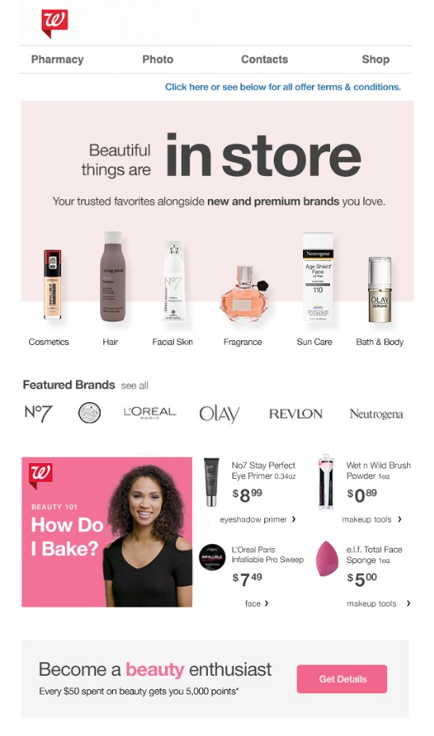
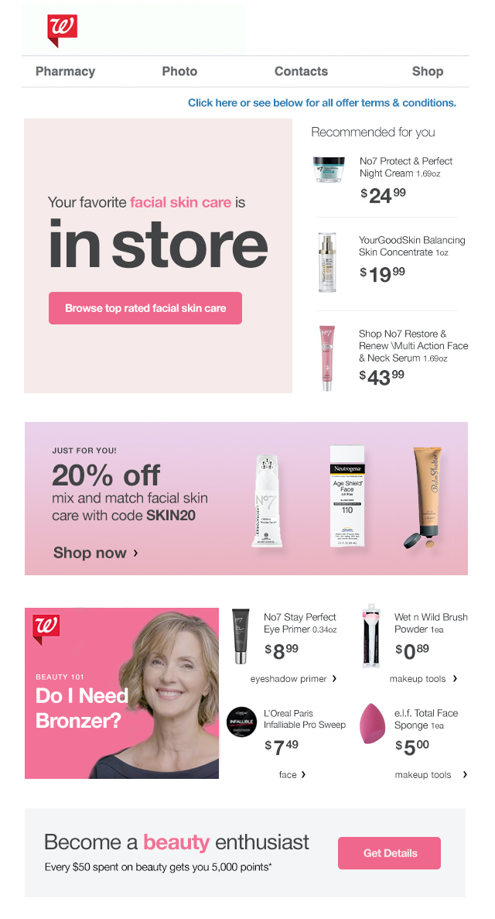
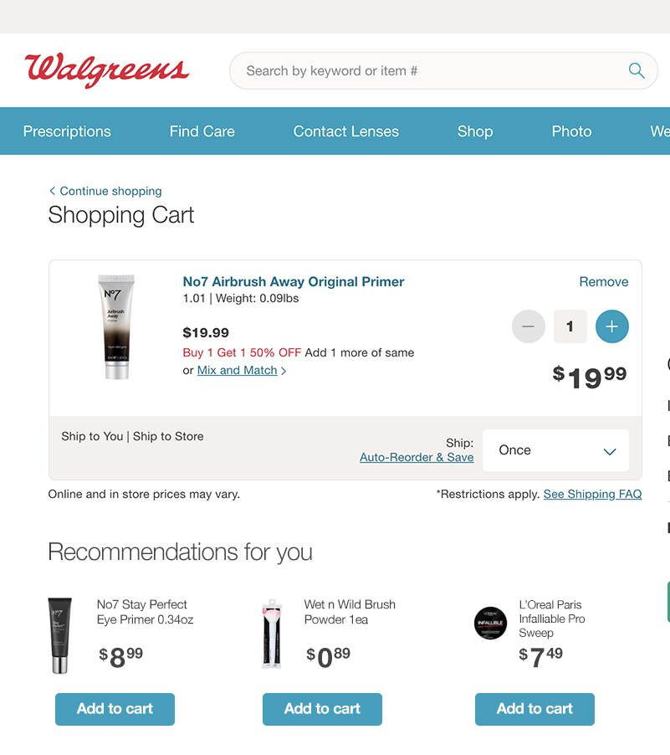
Bringing it to life…an illustrative example of our creative design
email
Category Product awareness
Personalized category recommendations
Recommend products component
WEBSITE CART
Variable content based on profile data
Personalized offer
CTA to purchase via video and to loyalty program

Slide 138



Beauty Audience Consumer Journey
The following provides a high level demonstration of our strategic approach and technology integration for the Beauty use case
Objective / Proposed
Establish Walgreens as a preferred one stop retailer for beauty products and advice
Increase awareness and gain market share from competitor specialty beauty retailers by driving in store and ecommerce visits via increased content relevance in offers for Beauty segment shoppers
Audience / Suggested
Female, 18-25 yrs old, urban
Still experimenting with new cosmetics and beauty treatments from multiple brands
Open to new products and ideas from multiple brands
Has not establish a regular beauty routine or preferred brands
Primary KPI / Anticipated
Increased beauty customers share of wallet

Slide 139













Beauty Audience Consumer Journey
 | Awareness | Exploration | Engagement | Commerce | Re-Engagement | Store Engagement | On-Going Engagement
Journey Experience | During her morning commute, Natalie is searching for makeup tips on her mobile. | Natalie sees and visits a YouTube video for a new make up technique. | Natalie subscribes to Walgreens YouTube channel and signs up for promotional emails. | Natalie receives an email coupon for the products in the video and purchases on Walgreens.com. She signs up for Walgreens Loyalty Program at checkout. | Natalie receives a personalized invitation to visit her local Walgreens for an exclusive beauty consultation in the mail. | During the consultation Natalie is introduced to a range of products and services. | Natalie receives periodic personalized emails with offers determined by her purchases and information provided to the in-store beauty consultant.
Engagement | Seo Sem Display banner | YouTube original video? Walgreens channel Youtube sponsored video Pre roll video ad Brand partnership video | Email YouTube channel updates | Email Walgreens.com Loyalty Banner retargeting Hero offer-web | Direct mail | Retail beauty advisor engagement | Email campaigns Landing page Loyalty
Enabling Technology | Adobe Analytics Adobe Experience Manager | Adobe Analytics Adobe Experience Manager | Adobe Analytics Adobe Experience Manager Adobe Campaign | Adobe Analytics Adobe Campaign Adobe Audience Manager Adobe Target | Adobe Campaign |  | Adobe Analytics Adobe Experience Manager Adobe Campaign Adobe Target
Natalie

Slide 140
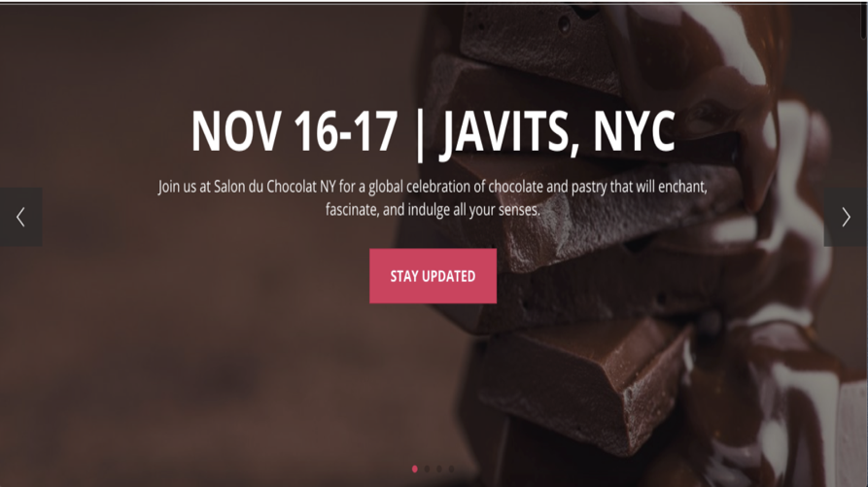
Events company / Campaigns
SUCCESS STORY
Approach
Target New York City Visitors to improve the registration and book ticket, through clicks on the banner CTA, registration page, and “Buy Now” Button
Target Non NYC visitors to landing page with Default Discount Offer, through clicks on the banner CTA and “Buy Now” Button
Success Criteria - Interaction with “Buy Now”
Challenge
The company wanted to:
To target new Visitor (Experience Targeting – New York City (NYC) Visitors)
To target Non NYC visitor (Experience Targeting)
44%
48%
Optimization of targeting model and increased interaction with Buy Now activity on site
Adobe Products
increased Buy Now click through for NYC visitors
increased lift in page views by Non NYC visitors

Slide 141
Localizing for Boots
Understanding the campaign strategy, customer journey, data, and KPIs to power the Boots use cases.

Slide 142
We’ve broken down each Boots use case to demonstrate how each would come to life with Adobe.

Slide 143



It’s starts with understanding the user journey
A connected journey spanning the 3 use cases - from when an anonymous visitor converts to a Boots customer and how they engage with the brand when redeeming Boots points, abandon a purchase or need a product replenished
KEY
Adobe Target
Adobe Analytics
Adobe Audience
Manager
Points Redemption
Product Replenishment
Adobe Campaign
Adobe Experience Manager
Abandoned Basket
 |  | Awareness | Consideration | Intent | Purchase | Post-purchase
Customer mindset / actions
Boots platform using adobe capabilities
ANONYMOUS VISITOR
REGISTERED / IDENTIFIED VISITOR
An anonymous visitor browses the site and leaves without making a purchase or registering an account
Over the following days the visitor is targeted with ads and banners on the websites that they visit regularly
Two days later, the visitor clicks on a banner to Boots as they know that they shop in store a lot and it might be worth registering for a Boots card. She decides it is worth it and signs up
Alice’s details are captured as she consents to Boots data capture and communications. She also downloads the app because it’s useful on the go and she’s often browsing on her mobile
Alice sees offers and recommendations that match her taste and buying habits. Having received a nice welcome email, she starts to think about what she needs. She visits the site and sees that a lot of the products she was looking for before seem to appear first which is useful
Alice fills her online basket with No7 products but is distracted and leaves the site before confirming her purchase
Alice is delighted with most of her purchases but needs to return one to her local store as it’s not quite what she thought it would be
Alice has a a busy life and often doesn’t notice when she is due to run out of cosmetics or toiletries – it’s very useful that she can be notified when different products that she knows she likes are available
Acquisition campaign through Adobe Audience Manager for targeted audience based upon existing audience segment draws new customer to a tailored landing page
As the anonymous visitor browses the site the data is captured and sent the Adobe Analytics - Adobe Target draws on the behavioural and segment data to tailor content served by AEM and serve relevant offers
As part of various segments in Adobe Audience Manager, the visitor is targeted with ads and banners on third-party websites
As the visitor signs up, she consents to receiving further comms and captures high level products and channel preferences. she is also encouraged to download the app so she can keep track of her points balance. the website is now tailored to her needs and behavior, displaying articles and images related to products she’s interested in..
After registering, Alice is segmented based on her 1st, 2nd and 3rd party data, content engagement as well RFV and a unique mix of offers / recommendations are determined - an email is sent through Adobe Campaign to welcome her to boots and to share with her contextually relevant content and CTAs - testing whether she wishes to join specific audience groups
Alice now visits the website, her information and previous engagement with Boots is used to tailor the content and to drive a desired behaviour
Later that day a message appears on her iPhone reminding her that her basket contains a time limited offer and asks if she wants too proceed - the purchase is completed through the app
As she approaches the store her App pings and let’s her know of an instore promotion from a trusted partner - In addition to the return Alice buys the instore offer and her points are updated in real time
A week later, Alice receives news that one of her preferred products is now back in store - even better she has enough points to redeem and get it right for free!
One month later, the No7 moisturiser Alice purchased will need replacing soon. Boots sends a message about replenishing the product with a direct link to the product page
She also agrees to receive communications and with the terms of use and conditions
A few days later Alice is asked to complete a short survey on her experience - as she completes the survey more data is captured to enable boots to personalise her experience and to enable boots to refine the targeting of new audiences through Adobe Audience Manager

Slide 144
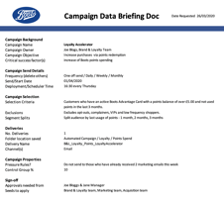
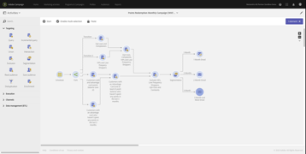








Points Redemption –Always On Marketing
KEY
A representation of the technology, resources involved, tasks and activity behind each Use Case
Adobe Target
Adobe Analytics
Adobe Audience
Manager
Adobe Campaign
AEM
Role | Data Science Engineer | Campaign Owner | AEM Email Builder, Marketing Ops, Analytics Manager | Marketing Ops | Data Science Engineer | Campaign Owner | AEM Email Builder, Marketing Ops
Objectives | Using data from various sources including AA and AAM, create prediction model to outline segments and suppressions | Creative and Data briefs created by Boots and sent to teams to build | Content & personalization configured in AEM Campaign workflow built out in AC Boots website configuration for campaign tracking | Campaign Go-Live! | Campaign reporting & recommendations | Campaign recs and changes - briefs and Playbook updated | Campaigns and deliveries updated, further test-and-learn applied to constantly optimize campaign
Tech
FEEDBACK LOOP – CONTINUOUS CAMPAIGN OPTIMISATION

Slide 145






Product Replenishment – Behavioural Trigger
KEY
Adobe Target
Adobe Analytics
Adobe Audience
Manager
A representation of the technology, resources involved, tasks and activity behind each Use Case
Adobe Campaign
AEM
Role | Data Science Engineer | Marketing Ops Data Science Engineer | Marketing Ops | AEM Email Builder | Marketing Ops | Data Science Engineer | Campaign Owner | AEM Email Builder, Marketing Ops
Objectives | Define model approach - Model 1 - Product Replenishment Cycle - Model 2 - User Transactional Behaviour - Model 3 - Prioritization and Pressure Rules | Provide sample data for model segments Finalise modelling | Productionise model & feed to Adobe Campaign. Extend AC schema for modelling data so that it can be utilised in campaign workflows | Build dynamic email in AEM with variations to cover different segments | Campaign Go-Live! | Campaign reporting and recommendations | Campaign recommendations and changes – briefs and Playbook updated | Campaigns and deliveries updated, further test-and-learn applied to constantly optimize campaign
Tech
FEEDBACK LOOP – CONTINUOUS CAMPAIGN OPTIMISATION
Notes:
Start journey as unknown user (Visitor) and match cookies when sign up for membership
Sofia is browsing the web preparing to become a “first time mother”. She is looking for baby bath, she searches on Google where Fisher-Price Rinse & Grow tub appears on the top 5 list.
Sofia clicks on the Rinse & Grow tub link and lands on the product page
Sophia reads the product details, reviews and compare other products
She browses the FisherPrice articles and products that draw her attention but is not completing her baby bath buy.
Sofia is target by baby bath banners on 3rd party sites
A few days later she click on the media banner and comes back to the Fisher-Price site and it is now showing an experience theme that fits her behaviour from the last visit – presenting more articles also read by other visitors/users who read her first articles
She reads more articles and sees that all registered individuals will get diapers, wet wipes and general information about child minding, and decides to register for the Fischer Price New Born Registration (Accepting brand email marketing terms of use (double-opt-in).
Continue the journey as know user and the Adobe solution reads her browser cookie from her time as visitor and added her behaviour to her new profile
Sofie receives a welcome email that gives her a discount on the Fisher-Price Rinse & Grow tub which she now decides to buy. The welcome email also contains a short interest survey - but is too busy to answer
2 weeks later she receives a follow up email asking her to answer the survey.
Once Sophia opts in, Sofia’s online profile is linked to her CRM profile (address, child's name, child's age, purchase history, etc.
The New Born Registration form, enables Fischer Price to enable customer lifecycle management at key events of the child to promote educational toys for birthdays, or seasonal campaigns
When Sofia now lands on new born information page where she is targeted with new born products matching her demographic
A year after the birth of her child, her profile will automatically change to “Experienced parents”

Slide 146





Near Real-Time Trigger with Pipeline
Abandoned Basket
KEY
Adobe Target
Adobe Analytics
Adobe Audience
Manager
A representation of the technology, resources involved, tasks and activity behind each Use Case
Adobe Campaign
AEM
AEM screenshot
Role | Data Science Engineer | Analytics Manager Marketng Ops | Marketing Ops AEM Email Builder | Marketing Ops | Marketing Ops | Data Science Engineer | Campaign Owner | AEM Email Builder, Marketing Ops
Objectives | Analysis into data requirements from AA | Vis Pipeline, push abandoned basket data from AA to AC | Configure campaign workflow using data from AA Build dynamic email with variations to cover different segments | Push segment to AAM for media activation and Urban Airship for Push | Campaign Go-Live! | Campaign reporting and recommendations | Campaign recommendations and changes – briefs and Playbook updated | Campaigns and deliveries updated, further test-and-learn applied to constantly optimize campaign
Tech
FEEDBACK LOOP – CONTINUOUS CAMPAIGN OPTIMISATION
Notes:
Start journey as unknown user (Visitor) and match cookies when sign up for membership
Sofia is browsing the web preparing to become a “first time mother”. She is looking for baby bath, she searches on Google where Fisher-Price Rinse & Grow tub appears on the top 5 list.
Sofia clicks on the Rinse & Grow tub link and lands on the product page
Sophia reads the product details, reviews and compare other products
She browses the FisherPrice articles and products that draw her attention but is not completing her baby bath buy.
Sofia is target by baby bath banners on 3rd party sites
A few days later she click on the media banner and comes back to the Fisher-Price site and it is now showing an experience theme that fits her behaviour from the last visit – presenting more articles also read by other visitors/users who read her first articles
She reads more articles and sees that all registered individuals will get diapers, wet wipes and general information about child minding, and decides to register for the Fischer Price New Born Registration (Accepting brand email marketing terms of use (double-opt-in).
Continue the journey as know user and the Adobe solution reads her browser cookie from her time as visitor and added her behaviour to her new profile
Sofie receives a welcome email that gives her a discount on the Fisher-Price Rinse & Grow tub which she now decides to buy. The welcome email also contains a short interest survey - but is too busy to answer
2 weeks later she receives a follow up email asking her to answer the survey.
Once Sophia opts in, Sofia’s online profile is linked to her CRM profile (address, child's name, child's age, purchase history, etc.
The New Born Registration form, enables Fischer Price to enable customer lifecycle management at key events of the child to promote educational toys for birthdays, or seasonal campaigns
When Sofia now lands on new born information page where she is targeted with new born products matching her demographic
A year after the birth of her child, her profile will automatically change to “Experienced parents”

Slide 147




Swisscom / Campaign
SUCCESS STORY
Approach
Local onsite team with project manager, subject matter expert and business analysts worked alongside a remote delivery team.
Integrated the solution tightly into the existing Adobe Marketing platform to benefit from synergies and future extensions.
Implemented a data model which caters to entirely different needs of 5 divisions.
Challenge
A single platform for five divisions needed to be provided, each with very different demands. The new solution had to be integrated into the Swisscom IT environment, including deliverability as well as into the existing data landscape and processes.
A perfect fit to Swisscom’s existing tools & processes
Flexibility for future adaptations and simplification
Personalization can be built on existing Swisscom data
Adobe Products

Slide 148
Elevating Optimization
Capturing campaign performance analytics, globally, to continuously inform and enhance future campaign planning & execution.

Slide 149





Campaign Continuous Optimization Process
Plan Campaign Owner defines requirements of the campaign. Typically with campaign results from the Data Science Engineer. Design Data Science Engineer defines data requirements to measure campaign success indicators. configure Marketing Operations (AC) and AEM Email Builder teams build or refine campaigns in the tools. Execute Amended (and hopefully improved) campaign is deployed by Marketing Operations and run for a certain period of time to capture results. Evaluate Data Science Engineer and/or Analytics Manager review campaign results, feedback to Campaign Owner and propose further improvements.
Plan
Design
Analytics and Marketing SMEs will look at performance to continuously inform future campaigns
Feedback
Evaluate
configure
EXECUTE

Slide 150
Cognizant Applies Data and AI lenses to Hypotheses that inform future targeting, segmentation, and campaign planning/execution
What are the Next Best Recommendations for our loyalty customers?
How can we use Artificial Intelligence and Machine Learning to improve regional personalization and New Mover messaging
Why is our loyal customer AOV at an all time high in store XYZ?
How can we improve targeting profiling and segmentation (e.g. Rx Fill->in store purchase)?
How can we leverage online customer engagement to drive in-store footfall at the regional level (city/state/US v UK)?
Why our customers may prefer (acquire) or switch (retain) to other beauty retailers?
How can we use Artificial Intelligence to support hypothesis development for A/B testing

Slide 151

As we further leverage AI, Cognizant can applying Our Proprietary AI Framework (LEAF) to Campaign Execution Optimization
Digital
World
3
drives
Evolutionary-Based
Prescriptions
4
surrogates
creates
continuous adaptive
APPLIES
Causality-Based
Predictions
influences
Real
World
2
1
actors
5
1 | 2 | 3 | 4 | 5
Campaign data is collected through marketing automation platform and third party sources. Data sources are normalized and rationalized into a common machine learning format. | Using Mutual Information Theory (MIT), causality analyses are performed to determine what data sources and characteristics are causal to best campaign performance (based on pre established goals). | Using Evolutionary Neural Networks (ENN), high fidelity causally-based predictive models (digital surrogates) are created from the causal data. | Using Evolutionary Surrogate-assisted Prescription (ESP), prescriptive activities and characteristics are created over millions of simulation runs with varying campaign performance parameters. No additional client data is needed for this development. | The prescriptive actions are applied to campaigns (offer details, email scripts, development of new message content, next best action identifications, etc.) that directly impact customer behavior.
Notes:
Optimization can be at multiple levels
Spread or Reach: Changes to geo target, devices, day and time
Content: Changing look and feel of campaign ads/ email etc, based on user response
Audiences: Changes to first or third-party target audiences
Buy Side: Bids for media buys across channels
Portfolio Spend: Marketing budget across different campaigns and product categories

Slide 152
Ready-to-Scale
Leveraging the pilot learnings to enable a scalable model to support additional campaigns, volume, and localization needs.

Slide 153





Looking Forward…
Template Build
SCALING CONTENT, SEAMLESSLY
Adaptation
As we learn from the E2E execution of the initial batch of use cases, Cognizant’s Digital content/production model can offer efficiency, scale and standardization for WBA and Boots for future campaign execution template builds, adaptation and localization as well as refresh content, track and report.
Localization
DIGITAL FACTORY
Content Refresh/ Updates
Content Tracking and Reporting

Slide 154
The digital factory can unlock significant value for WBA
LEVERS
IMPACT
Decoupled,
centralized staffing
20-60%
cost savings
Standardized
service model
10-50%
reduction in cycle time
50-70%
greater asset reuse
Accelerators
// Scale predictably and efficiently
// Standardize, optimize and flex
// Automate to accelerate
// Strategically partner for innovation
Catalogue-based
pricing
99%
on-time delivery

Slide 155
We can take learnings from the pilot use cases to build a customized pricing catalogue to enable a predictable and efficient scaled rollout*
CATEGORY | ASSET | LOW | MID | MAX
Banner | Banner development | $234 | $467 | $701
 | Banner rich animated media (video included) | $1,051 | $1,518 | $2,803
Email | E-mailing template production (e.g. 2 contents: 1 video and 1 text) – creation | $234 | $409 | $526
 | E-mailing template production (e.g. 2 contents 1 video and 1 text) – adaptation | $117 | $175 | $292
 | E-mailing template production (e.g. 2 contents 1 video and 1 text) – refresh | $117 | $175 | $234
Edetailing | IVA (Interactive Visual Aid) 5 pages including 2 tables, 4 graphs, 2 images and 1 video – new creation | $292 | $409 | $584
 | IVA (Interactive Visual Aid) 5 pages including 2 tables, 4 graphs, 2 images and 1 video – adaptation | $175 | $292 | $409
 | IVA (Interactive Visual Aid) 5 pages including 2 tables, 4 graphs, 2 images and 1 video – refresh | $117 | $234 | $292
Website | Static website page with 5 contents (text and images and 1 video) – new creation | $467 | $701 | $1,402
 | Static website page with 5 contents (text and images and 1 video) – adaptation | $234 | $350 | $701
 | Static website page with 5 contents (text and images and 1 video) – refresh | $234 | $350 | $584
 | Dynamic website page with 5 contents (text and images and 1 video) – new creation | $7,008 | $10,372 | $15,978
 | Dynamic website page with 5 contents (text and images and 1 video) – adaptation | $3,644 | $4,765 | $9,251
 | Dynamic website page with 5 contents (text and images and 1 video) – refresh | $1,962 | $3,644 | $7,008
*Illustrative catalogue pricing for the Cognizant’s Content Factory

Slide 156


Day 1 team profiles
ANGUS BURGESS
MARKETING LEAD
CARLA BOBKA
US PROGAM LEAD
25+ years of experience in leading Marketing engagements
20 years’ experience developing digital marketing strategies and program execution.
Subject matter expertise in digital media, CRM, social media, mobile marketing, content development and data analysis.
Extensive experience with digital operations and partner management
Experience in both CPG (domestic and global and Life Science/healthcare industries
20+ years experience as Program Lead for multiple clients including Fortune 100 client in NA
Design and implementation of SAP integrations supporting new distribution channel for consumer products division of major pharma client.
Experience in driving effective interfacing between the global technology, strategic business functions, development and testing teams across the development lifecycle
Spearheads stakeholder communications with client leadership, and initiates continuous improvement to optimize the program as the client business environment evolves.
BACKGROUND
Enterprise Digital Strategy development
Digital and Social marketing
Customer Journey Mapping
CRM Strategy
Marketing Analytics and C360
Mobile Marketing
Marketing Operations
Market and Usability Research
Insight generation
Program Management including Coordination with offshore program managers and onshore resources for demand management, resource planning
Deep understanding of intersection between technology and marketing and ability to streamline communications between agency and technology teams
Abode stack expertise working with AEM, Analytics
EXPERTISE

Slide 157


Day 1 team profiles
KAUSIK P
SR. CAMPAIGN MANAGER
PAULINE PETSCHELT
CREATIVE LEAD
Seasoned Marketing Ops leader with total of 18+ years of experience in areas of CX & program delivery of multi channel programs across industries.
Led the delivery and managing multiple projects on digital marketing domain.
Experience in handling end to end project delivery.
Leading various infrastructure assessments, Data Center consolidation and cloud migration projects. Demonstrated strong command in providing advice and cutting edge technical solutions to customers.
14+ Years experience leading creative design, UX, strategy and branding efforts.
10+ years in direct marketing leading creative design and implementation.
Proactive thinking always asking the “why” to inform crafting meaningful experiences for clients and end users.
Experience across industries including Life Science, Healthcare, Insurance and Retail.
BACKGROUND
Marketing campaign management (MCM)
Resource management (MRM)
Specialized skill sets in infrastructure architecting & solution building for on-premises & cloud (AWS) deployment
Cross channel campaign management and execution
Analysis & reporting
ITIL, TOGAF processes and ensuring their adherence across the organization
Design thinking
Customer Experience planning
UX Design and testing, wire framing
Abode Creative Cloud, Sketch, Zeppelin
AEM Design Specifics including deep understanding of component
CRM and marketing Automation
Interactive displays
EXPERTISE

Slide 158

Day 1 team profiles
JAN HAIG
CONTENT STRATEGY & COPY DEVELOPMENT
20+ Years developing and telling the right story in the right way to key audiences
Experience in professional services, healthcare and life sciences and manufacturing
Managed content revamp and creation for globall biopharma company
Developed key messaging for account-based marketing campaigns across multiple stages of the customer journey
BACKGROUND
Personas and customer journey creation
Content planning and development mapped to the sales funnel
Communication strategy
Content audit, assessment, mapping
Content calendars and editorial schedules
Writing and editing marketing & promotional campaigns
Patient education to physician forums
EXPERTISE

Slide 159


Day 1 team profiles
Mahmud Shah
UK MARKETING LEAD
Jennifer Turnbull
UK CAMPAIGN LEAD
A highly experienced consultant who combines excellent hands-on technical skills with in-depth knowledge of customer management including effective communication strategies.
Mahmud brings together both business led strategies as well as technical know how to implement complex marketing systems. Confident with clients at all levels ranging from senior management to highly technical resources.
Over 25 years working with Brands including Vodafone, Chelsea FC, Direct Line Group & Telegraph Media Group
Technically competent working with a wide range of campaign management systems and analytical tools. Additional skills within areas related to digital marketing, reporting and data visualisation.
Most recently working with the Adobe Marketing Cloud bringing togethertightly integrated marketing solutions joining on-line and off-line data to enrich highly targeted communication strategies.
Jenny has supported a number of clients on implementing and leveraging Adobe Campaign to meet their business requirements while following best practice. With a solid understanding of database marketing, Jenny has helped clients maximise their marketing technology stack to build out their customer journey and recognise their marketing vision.
Jenny has been deployed client-side with several major telco and media organisations including GiffGaff, Dixons Carphone and NowTV
Across each engagement her expertise as an Adobe Campaign Marketing Ops Consultant has been applied and enabling clients to fulfil their ambition to be self sufficient.
Certified across AEC including AEM, Adobe Target, Adobe Campaign Classic & Adobe Campaign Standard
BACKGROUND
Comms Strategy and Execution
Solution Development
Business Process Redesign
Vendor Assessment
Multi-supplier Collaboration
Multichannel Campaign Design
Next Best Offer Design and Execution
Loyalty Management
Detailed Definition
Discovery and Design Ahead of Systems Integration
Onsite Campaign Orchestration and Team Enablement
Requirements Engineering and Delivery Lead
Team Leadership
Resourcing and Mentoring
EXPERTISE

Slide 160


Day 1 team profiles
Chris Merriman
UK MARTECH ENGINEER
Chris Sollieri
UK DATA LEAD
Chris is a Marketing Technology Consultant with +10 years of experience in marketing automation solutions. Chris is an Adobe Campaign Standard SME, and has worked with the Adobe team to help them produce exams for both Adobe Campaign Classic and Adobe Campaign Standard.
Chris has applied his expertise to projects that span multiple verticals. During his time working with campaign he has been responsible for creating:
An email editor that gave clients a much improved email editing experience when compared to the standard ACC editor.
Custom channels for ACC - allowing AC to connect to non-standard channels
Automated campaigning - allowing clients to perform initial setup in a tool outside campaign.
Chris has extensive experience as an Adobe Campaign SME, supporting some of the UK's largest brands implement, integrate and grow their customer experience management capabilities.
In recent years, Chris's focus has been to engage and direct enterprises on their wider martech investments, leveraging and streamlining the integration and onboarding of additional Adobe Experience Cloud products with an intent on delivering true business value.
Chris has worked for several marketing agencies in past years, specifically Celerity IS (now a Paragon Company) and DBG (now a Merkle Company) across multiple industry verticals.
Certified across multiple AEC solutions
BACKGROUND
Detailed definition, Solution Design and options assesment, Onsite Campaign Orchestration, team enablement, Solution Development, Vendor Assessment, Multi-supplier Collaboration, multichannel campaign design, Next Best Offer design and execution, loyalty management.
Capability readiness assessment, Data management process design, Analytics scoping and requirements gathering, AEC systems integration, Campaign Orchestration and team enablement, Transition management, Training and mentoring
EXPERTISE

Slide 161





Project Fiore success requires understanding and execution. Cognizant is the partner to deliver on this promise.
1 // We are the only partner to provide end to end services for Project Fiore We will provide a smooth and effortless transition from technical integration to platform campaign execution Internal and client communications channels are uncomplicated and straightforward with one individual project partner for direct resolution in case of escalation Shared knowledge and experience aid in uncovering innovative ideas across the delivery chain | 2 // We know the technology Our Integration and tech teams understand deeply the CSFs for execution success and our campaign delivery teams have Adobe and Data resources that “speak the language” minimizing questions / delays in production ​ | 3 // We are a global team that thinks locally Our highly skilled ​and flexible global teams will apply ​our unbeaten expertise in building and running complex MarTech solutions​ | 4 // At its core, we’re transforming how we engage with customers Everything we’re doing is to drive a deeper understanding of how to connect with the audience, meet them at their moment of truth and enable transactions with ease. And personalized experience start with a deep understanding of audience, and gathering, analyzing and leveraging DATA to drive more relevant experiences, learn from performance and optimize continuously. | 5 // Cost, quality and value Our team structure and operating model deliver execution efficiency through standardization at the global level, campaign best practices in omnichannel environment, with local execution teams to ensure regional relevancy: Balancing speed and cost to deliver value internally for WBA and externally to Walgreens and Boots customers

Slide 162




Assumptions and dependencies
Development | DATA | CREATIVE | TRAINING
Platform enablement, channel enablement, system integration and data model are in place before campaign execution work starts Integrations must be in place to pull content from AEM into Adobe Campaign Integrations must be in place to pull/push analytics/tracking data between Adobe Analytics and Campaign Platform access and Adobe support portal access is provided to the campaign execution team Test data is available as per planned timeline in dev/test environment All Adobe User ID’s must be associated with internal Walgreen and Boots accounts using SSO functionality IP warming must be planned to run in line with the initial outbound campaign in order that ramp up of volumes is possible in the proposed IP warming window | Data segmentation/supression to be handled by WBA Data aggregation and ingestion includes online and offline sources including loyalty data from Epsilon Standard out of the box reporting from Adobe campaign and analytics is used for campaign reporting and optimization All data required by campaigns is in the Adobe Campaign Schema as no external data pull has been costed for Test data will be available as per planned timeline in dev/test environment | Use case brief to be provided by WBA (*Cognizant has pre-defined template that can be used by WBA) Creative direction (as part of brief) around imagery and copy tonality, key messaging to be provided Access to approved imagery from WBA to be provided Any new imagery required will require OOP funds to purchase Media plan (with ad unit requirements) to be provided by WBA Banner creation assumption for scope includes 3 sizes for 2 creative units WBA to provide approved use print vendors for Cognizant to pass DM files WBA Marketing team to provide single POC for asset deliver and review of design/copy All creative work for outbound campaigns must completed by Boots prior to the campaign creation in Adobe Campaign | Training will be provided to the campaign execution team to understand the data model, security structure and other already built aspects of the platform

Slide 163
Managing Adoption & Change

Slide 164


Program Fiore will bring
significant changes to WBA.
That’s why we recommend thoughtfully guiding the organization along this journey.
We’ve put together an approach to ensure WBA teams are equipped to understand, adopt and enjoy the new ways of working that Program Fiore will bring.
WHAT YOU’LL NEED
CHANGE
MANAGEMENT
TRAINING

Slide 165
Key factors for managing change for Project Fiore
01
04
ESTABLISHING A COLLABORATIVE WORK CULTURE
END USERS IN MULTIPLE OFFICES
Centralized OCM team supported by offshore developers
Cognizant to engage WBA change agent network across multiple locations
Establish vision and case for change
Leverage user personas to develop journey maps
02
05
TRAINING USERS ACROSS DEPARTMENTS AND FUNCTIONS
ACCOMMODATING TWO COUNTRIES
Customized roll-out of communications in the US and UK (kiosks, virtual lunch-and-learns, handouts, chair drops)
Standardized learning and communications across use cases
Learning maps based on segmented personas
WBA specific learning materials based on learning complexity and user need
03
NEED FOR AWARENESS
Establish key user personas based on segmented user needs within WBA use cases
Unified awareness campaign across WBA (awareness posters, danglers, tent cards, targeted emails, etc.)

Slide 166
We propose a Project Fiore OCM approach that filters through complexity to provide organizational clarity
SCOPE
CHALLENGE
SOLUTION
PEOPLE
US and UK
What’s in it for me?
Leadership Alignment
Stakeholder Engagement
Unified Vision and Collaboration
ROLES
Four Use Cases
How is my role changing?
Communications
Organizational Design
Tailored and Consistent Messaging
PROCESS
Multiple Process Changes
How do I use these new tools?
Enterprise Learning
Change Impacts
Customized Learning Methods
TECHNOLOGY
Cross Functional Dependencies
What are these new tools?
Communications
Transparency through Education

Slide 167




Our OCM tools and templates
We will bring well defined tools and templates to understand stakeholders, gauge the impact of upcoming changes, drive communications, manage a change network and provide an environment conducive to adoption.
STAKEHOLDER ANALYSIS FINDINGS
CHANGE IMPACT ASSESSMENT
30-60-90 DAY
COMMS PLAN
COMMUNICATION COLLATERAL

Slide 168
Our training approach will blends web-based, instructor, and micro learning that is cost-effective and sustainable
WBA ENTERPRISE LEARNING
Methods & Design
Development
Delivery
Flexible and modular curriculum based on skills assessments and WBA role design
Hands-on learning techniques such as demonstrations and exercises
Training environment mirrors the production environment and is available post go live
OBJECTIVES:
Present MS Dynamics/Adobe and WBA business processes
Demonstrate how tasks are performed
Practice tasks in a virtual or physical classroom
Provide on-the-job access
Develop relevant and comprehensive process and role-based training materials for users
Provide training materials to users that are concise and consistent
Provide templates to the training developers for consistency in structure and format
Use accelerators to shorten material development time
Mix of coaching and instructor-led training
Scenario-based instruction
Train-the-trainer approach

Slide 169





Our enterprise learning tools and templates
We will use the following tools and templates to understand organizational and individual needs, create a training strategy, and drive training development and delivery.
TRAINING NEEDS ASSESSMENT
TRAINING STRATEGY
TRAINING PLAN
CURRICULUM
JOB AIDS

Slide 170





How we’ll focus our WBA OCM and enterprise learning program
STRATEGY TO LEAD CHANGE | STAKEHOLDER ENGAGEMENT & EXPERIENCE | COMMUNICATION & FEEDBACK | CHANGE IMPACT & READINESS | LEARNING & SKILLS DEVELOPMENT
Customized approach for change adoption focusing on the use cases and key areas of WBA’s Fiore program | Identify and engage WBA leaders and stakeholders, to listen, understand risks, understand concerns, and share key findings with the Fiore leadership | Planning communications, deliver key messages to WBA stakeholders (e.g. kick off meeting, program updates) to increase awareness and understanding, drive engagement, readiness and adoption of the Fiore program | Identify major program changes and transformation impacts (and benefits) to key stakeholders. Create mitigation plans and actions to address impacts. | Understand the learning and skills development needs for Fiore end users to prepare them to perform their jobs well and adopt the new platforms
DELIVERABLES
Impact Assessment
Change Strategy (high-level)
Change Plan
Stakeholder Identification
Communications Strategy
Communications Plan
Training Strategy & Needs Assessment
Training Plan
Training Curriculum and Materials

Slide 171
Our high-level Project Fiore OCM program
BLUEPRINTING
IMPLEMENTATION
POST-IMPLEMENTATION
CHANGE STRATEGY
Exec Visioning
Develop Vision Statement
Refine and Update
Create Change Strategy
STAKEHOLDER ENGAGEMENT
Identify
stakeholders
Prepare
Interview guide
Conduct
interviews
Conduct additional
interviews
Provide Stakeholder
updates
Repeat per
release
COMMUNICATION
Create Comms Plan
Develop Comms
Deliver Comms
Prepare Comms
Strategy
Adoption Comms
Repeat per
release
IMPACTS & READINESS
Identify dimensions and
expected scores
Conduct change impact and
readiness assessment
Address impact and
readiness gaps
Implement change impact
action plan
Repeat per
release
LEARNING & DEVELOPMENT
Create Training
Strategy
Training
Development
Deliver Training
Post Launch
Survey

Slide 172
Key roles and responsibilities
Key roles and responsibilities
KEY ROLE | KEY RESPONSIBILITIES | %
OCM Exec Lead | Stakeholder management Provide review, insights, and best practices | All tracks
OCM Lead -- US | Communication strategy and plan | 50% Harmony 50% Walgreens --Marketing
OCM Lead -- UK | Communication strategy and plan | 50% Wonder Woman 50% Boots --Marketing
Enterprise Learning Lead -- US | Learning strategy, curriculum, manage learning development | 50% Harmony 50% Walgreens --Marketing
Enterprise Learning Lead -- UK | Learning strategy, curriculum, manage learning development | 50% Wonder Woman 50% Boots --Marketing
Training Analysts – US, UK, India | Design training materials Develop training materials | 50% Wonder Woman 50% Boots --Marketing

Slide 173







Case Study
SUCCESS STORY
Driving Adoption for a Digital Workplace
Adoption Strategy
THE STORY
WE DELIVERED
The client sought to roll out a new digital collaboration platform for employees: Digital Workplace.
Cognizant was hired to assess, improve, and run the Change & Adoption work stream with the objective to:
Create awareness about the project and the business goals
Help understand changes and benefits of the move
Identify and address perceived friction points
Ensure readiness to start working on the new platform
Build organizational capabilities to drive sustainable adoption and productivity
Designed and implemented a change management approach to guide people through the transition to the new platform, including:
Vision for change
Change impact assessment
Launch marketing campaign
Learning and support portal
Migration communications plan and templates
Performance support and e-learning materials
Change measurement plan
Designed and started implementing a pragmatic and outcome driven approach to drive sustainable adoption in the business, including:
KPIs and measurement plan
User stories and personas
Productivity scenarios
Marketing campaign
Change Journey Map
Business and IT stakeholders understand and support the transition
Solid understanding of impact of the change and how to deal with it
Business users, as well as site owners, better prepared and guided through the transition
Increased platform adoption rates = more value for the investment
Capabilities in place to drive sustainable adoption and productivity
360*
CLIENT IMPACT
View of customer
Digital Workplace Learning Portal
Faster creative build & approvals – more time for quality
Improved content relevance and engagement
Semi-automated regulatory compliance
PRODUCTS
LEVERAGED

Slide 174


Getting started: day 1 team profiles
DAN OTT
US OCM LEAD
ANTONY GREEN
UK OCM LEAD
Highly accomplished Organizational Change Management professional with experience delivering HCM and Organizational Change solutions in client delivery, business development and internal HR lead roles.
Experienced in Digital technology and highlighting the unique opportunities new technology provides in replacing or supplementing existing systems..
Dan has 18+ years of experience in change management consulting with a focus on Communications & Learning.
Currently focused on tech adoption solutions within the organization change management practice, Dan has led Change Management work-streams on several large transformative technology adoption projects.
Experienced digital transformation consultant with successful engagements in change management, organisational transformation and digital strategy. Antony has more than twenty years of experience in digital, working initially in establishing digital capabilities in creative businesses (operations), then systems and service development (delivery), organisational design (strategy) and organisational change management (OCM).
Antony has broad sector experience, notably in media and telecoms, pharmaceutical, creative agencies and the arts.
With experience of multiple working cultures and organisational models, Antony has great empathy and strong interpersonal skills, complemented by senior level experience of managing cross-functional teams and stakeholder engagement in multiple countries and regions.
BACKGROUND
Training Strategy, Planning & Development
Training Delivery
Comms Strategy & Execution
Facilitation Specialist
Solution Development
Business Process Redesign
Organisational Design, Target Operating Model, Pre & Post-Merger Operational and Culture Change, Change Readiness and Change Impact Assessment, Internal Comms, Vendor Assessment, Multi-supplier Collaboration, Digital Strategy, Skills and Role Assessment, Programme Recovery, Communities of Practice, Design Thinking
EXPERTISE

Slide 175
Governance & Team

Slide 176
Risk increases in highly complex and time-constrained delivery scenarios like Project Fiore
Potential Challenges
Program Success Factors
MISALIGNMENT OF FIORE GOALS
ALIGN ON FIORE VISION & NEEDED CAPABILITIES
Various program tracks within Project Fiore creating conflicting plans how to best address changing corporate and consumer needs
Alignment to vision and the overall WBA business strategy
& prioritize the necessary capabilities for investment
HIGH PROGRAM COMPLEXITY
GLOBAL & LOCAL PROGRAM LEADERSHIP
Significant technological impacts and interdependencies cross tracks which affects multiple functions and geographies
Global Transformation Office supported by local presence at both Walgreens & Boots driving Project Fiore
SIGNIFICANT OPERATIONAL RISK
ENHANCE OPERATIONAL EXCELLENCE
Potential disruption to customers, financial systems, high probability of time overruns, and delayed benefit realization
leveraging synergies between Walgreens and Boots tracks, and constant focus on WBA program goals
NEW BUSINESS PROCESSES
MANAGING ORGANIZATIONAL CHANGE
Change impacting large section of WBA employees. Effective communication and change management is recommended
Ensure organizational change management and adoption of newly implemented tools & technologies

Slide 177




We’ll need a strong MPO to overcome these challenges
OUR APPROACH TO CREATING A MODERNIZATION PROGRAM OFFICE (MPO)
01
Leadership: Orchestration
Define vision, program goals, and roadmap
Outline desired outcomes
Champion the end-state vision
Cognizant deploys Senior Executive Leadership to be involved and invested in program success
02
MPO: Planning, Governance, & Assurance
Establish program governance framework
Create program track charters
Devise integrated plans while managing the control, reporting, and oversight cadence
Quality deliverables
Seasoned Program Directors comfortable navigating initiatives at the Alliance level
Establishing a strategic Modernization Program Office (MPO) driving alignment and benefit realization
03
OCM: Change Adoption
Develop change, communications, and training strategies
Drive engagement, readiness, adoption
Executing an Agile structured approach to assess, design, Implement, and operationalize while providing Quality Assurance

Slide 178
Our MPO’s focus areas for the Fiore Project
Program
Orchestration
Successful execution of the Fiore Program will require orchestration efforts from the Modernization Program Office (MPO) at all levels, WBA, Walgreens, Boots and, respective program tracks.
1
Planning
The MPO will establish a rigorous top-to-bottom planning approach and enforce frequent and transparent status reporting to reduce risk and enable timely course correction.
2
Governance
The MPO will establish a tightly aligned set of Governance Bodies that can make decisions and communicate effectively to manage risks, changes, or high stake decisions on behalf of the Project Fiore.
3
Assurance
The expected impact, degree of change and level of associated risk of the Fiore program requires robust assurance. The MPO will own the responsibility for assuring the end-to-end process for the delivery of the Fiore Program to minimize the impact, control change, and eliminate risk.
4
Change Adoption
Design OCM and Enterprise learning strategies and plan OCM and Enterprise Learning activities across use cases and two organizations.
5

Slide 179
Activities & deliverables of the MPO throughout the program
Program Foundation (WEEKS 1-3) |  | Ongoing Execution (ONGOING)
Establish WBA roadmap Establish program roles & responsibilities Establish reporting cadence Draft, review and finalize Program Charter Create Project Fiore RACI | Define track specific KPIs Define and implement MPO processes: dashboard, metrics & KPIs, risk & issue management, etc. Gather refined Program Track plans and Establish sprint plans and backlogs Integration with OCM activities | Coordinate the end-to-end engagement capitalize on Walgreens and Boots tracks synergies Drive the modernization effort, prepare the organization for new capabilities and customer offering Execute MPO processes defined during the Program Design phase: Track & Refine Program, and Walgreens & Boots tracks plans. Monitor program milestones & activities Monitor and track Program dependencies and adjust strategy as needed Identify high level risks, mitigation steps Enforce Change Control (CR) process Complete Status Reports Governance and Reporting Schedule/hold Steering Committee review meetings Schedule/hold Program Tracks status review meetings
Program Roadmap Program Structure with Roles & Responsibilities Program Charter RACI matrix Program Governance Meetings | High-level / milestone driven project plan incl. dependencies Sprint Plan approach and Backlog report template Status Reporting templates Program Track Charters Change control process and template
// ACTIVITIES
// KEY OUTPUTS

Slide 180
Our recommended program structure for Fiore
Executive Steering Committee
WBA Program Sponsor
Walgreens Rep
Boots Rep
Cognizant Exec. Sponsor
01 Executive Layer Responsible for delivery strategy and overall program objectives. 02 Core Program Layer Modernization Program Office: Manages the overall program, ensures proper planning, governance, and coordinates the Walgreens and Boots end-to-end efforts. Technical Alignment Committee: Providers overall program technical leadership throughout the engagement. 03 Delivery Layer Track Leads: Lead execution of track(s), responsible for sprint planning, progress and Backlog quality.. Walgreens & Boots Delivery Leads: Provides offshore technical delivery leadership. Foundation Team: Creates the foundational blueprint for all in-scope technologies – Dynamics F&O, Dynamics Customer Insight, Adobe tech stack, Azure.
Modernization Program Office
Technical Alignment Committee
Global Program Director & Walgreens Lead
Boots Program Lead
Solution Architect
Head of Product
Global Planning Lead
Global Governance Lead
Track Leads or other Track specific SMEs will be pulled in, as needed, from the Delivery Organization
Walgreens OCM Lead
Boots OCM Lead
Walgreens Delivery
Boots Delivery
Product Manager
Product Manager
Product Manager
Product Manager
Product Manager
Product Manager
Delivery Team
Integration Delivery Team
Execution Delivery Team
Delivery Team
Integration Delivery Team
Execution Delivery Team
Walgreens Offshore Delivery Leader
Boots Offshore Delivery Leader
Foundation Team
Harmony
Adobe Implement.
Marketing Campaign
Wonder Woman
Adobe Implement.
Marketing Campaign
Notes:
Program Sponsor Executive Sponsor
Walgreens Rep. Global Program Director
Boots Rep.

Slide 181

Our recommended MPO team to ensure Fiore’s success
With an aggressive timeline and two separate client organizations, we’ll need a strong MPO with a local presence to drive execution and build support for the transformation agenda
Geo | Role | MPO Key Responsibilities
US | Global Program Director & Walgreens Program Lead | Coordinating the end-to-end engagement, leading the business modernization effort Establishes Planning, Governance, & Assurance model Provides reporting to governance groups (Executive & Program Committees) Manages all aspects of the execution of the Walgreens engagement Responsible for planning, governance & assurance, and overseeing sprint planning
US | Global Planning Lead & Walgreens Support | Responsible for establishing and tracking of the roadmap, dependencies and program status Walgreens engagement support, implementing program governance, assisting in The execution of the US tracks such as sprint planning and backlog quality
UK | Boots Program Lead | Sets up the program together with the Global Director and drives business modernization for Boots Manages all aspects of the execution of the Boots engagement Responsible for planning, governance & assurance, and overseeing sprint planning
UK | Global Governance Lead & Boots Support | Global Governance, Assurance and Lead for all 4 program tracks, In charge of consolidating program executive reporting as well as program communications Boots engagement support, implementing program governance, assisting in the execution of the UK tracks such as sprint planning and backlog quality

Slide 182
Ensuring quality governance for Fiore
 | WBA | COGNIZANT | GOVERNANCE RESPONSIBILITIES | MEETING FREQUENCY
STEERING COMMITTEE | Program Sponsor Program Director | Executive Sponsor Global Program Director Solution Architect | Program delivery strategy and overall program objectives Fiore program alignment to business objectives Escalation of program risks, issues and blockers Change impacts, change readiness, and adoption progress Benefit realization, course correction | Bi-weekly 1-2 Hrs
CORE TEAM | Program Director Product Owners Change Lead | Global Program Director Walgreens Program Lead Boots Program Lead Solution Architect Head of Product | Monitor progress to plan Track/resolve project risks, issues and dependencies Address System / Process Impediments Release planning and change management Program communication and executive reports Report achievement of defined program outcomes | Weekly 1-2 Hrs
DELIVERY ORGANIZATION | Business & Technical SME | Global Plan./Gov. Lead Track Leads Scrum master(s) Business Analyst(s) Developers/Quality engineers | Sprint planning (resources, deliverables/scope, timing, dependencies and risks/concerns) Manage project KPIs and agreed baseline capabilities Demonstrate finished product through Sprint Demo Identify impediments, minimize impact or escalate Process redesign to fully adopt system capabilities Status updates Prioritization | Daily 30 Min

Slide 183


Getting started: day 1 team profiles
PAUL TANSEY
GLOBAL PROGRAM DIRECTOR & WALGREENS LEAD
MARTIN EXNER
GLOBAL PLANNING LEAD & WALGREENS SUPPORT
Paul has more than 25 years of experience in delivering transformation initiatives across industries helping clients to prioritize their strategic investments to successfully execute end to end IT initiatives driving business results. Prior to Cognizant, Paul has managed advisory practices and held leadership roles in the leading digital service providers, in consulting, and technology start ups.
Paul’s primary expertise is in shaping and delivering large-scale programs with a focus on business change driving towards tangible business benefit.
Paul has a proven record of successful delivery of large, complex programs, assessing troubled initiatives, and advising on corporate and IT strategy.
Martin has 15+ years of cross-industry experience in Program Management and Strategy & Digital Transformation.
Martin supports organizations in their digital transformation challenges.
Work includes leading large digital transformations and managing the development of digital front-end solutions.
He also has extensive experience in supplier procurement, and management of 3rd party providers, including commercial negotiations.
One of his latest engagement were as Program Manager for the digital transformation of an airline's loyalty program. Implemented a loyalty system & oversaw web/mobile app development, driving member activation & customer satisfaction. Developed over 60 different business initiatives; dramatically improving front-end digitization & increasing revenues
BACKGROUND
Digital Transformation, Transformation management, Program management, Program rescue and assessment, PMO implementation and run, Enterprise Solution Implementation, Agile Methodologies
Large-Scale Program Management (PMI), Agile Project Management (SAFe), Strategy Development, Change Management , Digital Transformation, Customer Experience Development, Digital Marketing, IT Sourcing and Supplier Selection, Commercial negotiation, Retail, Healthcare, Aviation
EXPERTISE
183

Slide 184


Getting started: day 1 team profiles
DAVID HILL
BOOTS PROGRAM LEAD
AKSHAY LADDHAD
GLOBAL GOVERNANCE LEAD - UK
David is a Senior Manager from Cognizant's Digital Strategy UK&I Team and within Cognizant Consulting deployed across industry sectors.
Accomplished Business and Technical Consultant, possessing circa 25 years' international experience.
An experienced Programme Manager, a track record from pre study to delivery of a range of multimillion client programmes. Repeated success in full lifecycle delivery of IT and OT projects, managing large global delivery teams, developing strong working relationships with a range of stakeholders for governance. David has diverse capability, technology led business transformation roles from start up and recovery.
Akshay is a Senior Consultant within the Digital Strategy UKI practice.
He has a diverse experience as a project manager and governance lead across industry mainly retail, banking and life science.
His specialty is setting up program governance, executive reporting, execution of project plan and setting up controls.
His experience includes project planning, communication planning, facilitating change management workshops.
BACKGROUND
Programme Management & Delivery
Governance and PMO
Monitoring and Control
Hybrid Project Management
IT Enablement & Business Transformation
Project Management
Project planning and execution capability
Setting up Governance
Communication Planning and strategy
Executive Reporting
Tools – Jira, Service Now, MPP, HP PPM, PPT
EXPERTISE

Slide 185
Commercials

Slide 186
We have built our digital business to deliver programs like Project Fiore and we are committed and ready to deliver for WBA.
Based on our experience, the orchestration of work across multiple partners can significantly jeopardize efficient & quality delivery.
While we welcome working with WBA and other partners, given the timeline and complexity of these programs, we believe having a single delivery partner maximizes the potential for success.
Thank you for the opportunity – we look forward to working together to refine the program plans and scope.

Slide 187
Project Fiore pricing
Cognizant offers an aggressive total price for end-to-end delivery and is also willing to guarantee delivery timelines via fees at risk if awarded all Project Fiore tracks.
PRICING FOR 3 OR FEWER IMPLEMENTATION TRACKS
Use Cases | Full Scope | Implementation Scope
Harmony | $ 1.95M | $ 1.95M
Wonder Woman | $ 1.25M | $ 1.25M
Walgreens Marketing | $ 2.40M | $ 1.50M
Boots Marketing | $ 1.95M | $ 1.40M
TOTAL: | $ 7.60M | $ 6.10M
PRICING FOR INTEGRATED SCOPE COGNIZANT AWARD
Use Cases | Full Scope | Implementation Scope
TOTAL*: | $ 6.90M | $ 5.45M
Fees at Risk | ($ 345K) | ($ 275K)
Potential Total Savings | $ 1.045M | $ 925K
*5% potential fees at risk if delays greater than 5 weeks due to Cognizant.

Slide 188
Appendix

Slide 189








Program Orchestration Successful execution of H2 Fiore will require orchestration at all levels, WBA, Walgreens, Boots and respective program track. .
Vision/Mission | Workstream Complexity | Planning Excellence | Measurement
Roadmap
Design & Alignment
Orchestrate Multiple
Program Tracks
Planning
Orchestration
Orchestrate KPIs and Metrics
Design a roadmap that fits WBA’s timeline.
Based on business agreed features for each track within Walgreens and Boots
Lead program & track meetings
Own and manage the integrated cutover plan
OCM coordination and change adoption
Manage the end-to-end effort
Ensure track features are aligned with program roadmap goals
Orchestrate with consideration to track dependencies.
Realistic KPIs that exhibit ties to business indicators
Use of Agile metrics to measure progress against roadmap goals.
Automated metric gathering
Business Transformation | Communication | Governance | Delivery Quality
Customer Centric
Leadership Commitments
Program Governance & Assurance
Program Delivery
Excellence
Business transformation focused program execution
Experienced in delivering consumer focused digital products and services
Steering Committee materials
Orchestrate decision making through self organized teams,
Product owner and executive communication
Manage & support go-live
Orchestrated approach to managing information and decision making.
Program status reports and frequent track updates
Digital tools for information capture & actionable insights
Quality oversight by Cognizant leadership
Adoption of agile tools to track on-time delivery and solution quality
Change adoption that tracks to benefit realization

Slide 190


Program Planning Program Planning is an integral part of the implementation the Fiore Project . Establishing a rigorous top-to-bottom planning approach and enforcing frequent and transparent status reporting, reduces risk and enable timely course correction
How MPO Handles Planning Challenges
MPO’s Coordination of the Sprint level Planning and tracking of dependencies are fundamental to understand the Fiore Project level implications, and to carry out timely course corrections
MULTIPLE PROGRAM TRACKS
Creating an integrated plan across program tracks
PROGRAM WIDE DEPENDENCIES
Tracking of Dependencies that affect the overall delivery
SPRINT DEVIATIONS
Consistent Sprint planning and frequent Sprint reflections/Demos
BACKLOG QUALITY
Review of Backlogs to manage execution, and validate metrics against progress once Sprints commence
Feature and Program dependencies will be tracked by the MPO across The Harmony & Wonder Woman and the Marketing Campaigns tracks

Slide 191
Governance Controls At the core of the MPO, and in addition to the Planning and Interdependency management activities, will be the governance and assurance controls established during the Foundation phase of the engagement.
Key Control Areas
Key Activities / Deliverables
Articulate Vision, Mission and Goals and establish Program Charter with clear definition of done. Establish the Governance Framework that covers the necessary strategic, operational and tactical considerations of the transformation and outlines the Governance Bodies, Terms of Reference and RACI required to monitor and guide the transformation.
Determine and set up appropriate tool(s) to capture and manage program Risks, Issues, and track Decisions. Ensure correct level and frequency of discussion and where necessary escalation to ensure Blockers are addressed and solved.
Establish appropriate KPIs and Metrics to track the progress of the transformation. Articulate benefit categories and establish detailed Benefit Realization Plan together with WBA. Ensure ownership and accountability underpinned by regular tracking and reporting.
Establish clear understanding of information requirements for the program and design daily, weekly and periodic Reports to appropriately address their target audience. Understand sources and design data gathering processes to ensure timely and accurate insights. Automate where possible and leverage Dashboarding Tools as available.
Vision, Goals and Governance
Risks, Issues, Blockers & Decision Management
Metrics, KPIs and
Benefits Realization
Reporting

Slide 192

Assurance The expected impact, degree of change and level of associated risk of the Fiore program requires robust assurance. The MPO will own the responsibility for assuring the end-to-end process for the delivery of the Fiore Program to minimize the impact, control change, and eliminate risk.
IMPACT
MPO - Assurance approach & Escalation steps
Customer Impact
Streamlined process
Leaner administration
Cut-over orchestration
Scope Change Prioritization
Change Management & Decision Escalation
CHANGE
Managing an Aggressive Timeline
Full cross-system integration
Change & User Adoption
RISK

Slide 193
Assumptions Based on the provided RFP, written answers to questions and oral responses we have collected a number of assumptions that impact the separation of responsibilities between WBA and Cognizant concerning the MPO
ASSUMPTIONS
WBA has an enterprise PMO body in place that is providing necessary coordination, dependency tracking and insights regarding all other in-flight programs and initiatives that Cognizant will need to know about, plan around, or coordinate with.
WBA has a clear enterprise level governance and reporting structure and requirements in place that our MPO capabilities will be plugging in to this
WBA will be driving its own benefit Tracking and benefit realization (tracking against integration and strategic business objectives is WBA’s responsibility)
WBA will be driving the cost and budget management aspects of the program
Organization Change Management (OCM) is included for Walgreens and Boots Campaign tracks, however, OCM is not in scope for the Harmony and Wonder Woman tracks
Program Onboarding, and system access for all participants is the responsibility of WBA
That the program delivery approach and associated tools and reporting capabilities will enable quick and effective data roll up and report generation.
All WBA teams, and Vendors will have access to and is responsible for data entry in to a common system / tool to track and report planning and execution progress.
Artifacts/documents on current governance and delivery processes, standards, and definitions will be made available to Cognizant
Cognizant will work to align to WBA’s delivery methodology whenever requested and wherever possible.

